Slide 1
Sensor Fusion for NXP Microcontrollers – Part 1
Michael Stanley
NXP Sensors division

Slide 2
Part 1 vs Part 2
Part 1 (This course) focuses on the mechanics of getting a sensor fusion application up and running
Part 2 deals with some of the theoretical underpinnings
This course focuses on the Version 7.xx Sensor Fusion Library

Slide 3
Part 1 Agenda
Sensors 101
What is the sensor fusion library used for?
NXP Sensor Fusion Version 7.00
Supported hardware and how to get it
Sensor Fusion Toolbox for Windows
Sensor Fusion Toolbox for Android
Supported development tools and how to get them
Using the MCUXpresso Config Tools to generate a Version 7.xx sensor-fusion enabled SDK
Version 7.00 sensor fusion library structure
IDE Road Trip
Various Gory Details
Bare-Metal Implementation
Version 7.00 build process
Free-RTOS implementation
Fusion Standby Mode
Topics for another day

Slide 4


Navigation Icons
Is used to flag places where “you get stuff”
Is used to point out places where you need to do something

Slide 5
Documentation Included In The Sensor Fusion Kit
NXP Sensor Fusion User Guide
NXP Sensor Fusion Library for Kinetis Data Sheet
NXP AN5016, Trigonometry Approximations
NXP AN5017: Aerospace, Android and Windows 8 Coordinate Systems
NXP AN5018: Basic Kalman Filter Theory
NXP AN5019: Magnetic Calibration Algorithms
NXP AN5020: Determining Matrix Eigenvalues and Eigenvectors by Jacobi Algorithm
NXP AN5021: Calculation of Orientation Matrices from Sensor Data
NXP AN5022: Quaternion Algebra and Rotations
NXP AN5023: Sensor Fusion Kalman Filters
NXP AN5286: Rev. 2.0: Precision Accelerometer Calibrations

Slide 6
Sensors 101

Slide 7
An Accelerometer Measures Linear Acceleration Plus Gravity
An accelerometer by itself is a “3 axis” system
When any axis is vertical, we cannot
detect rotation about that axis
+Z
+X
Accelerometer
+Y

Slide 8
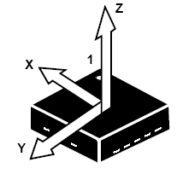
What Do We Mean: Accelerometers Measure Linear Acceleration Plus Gravity?
When horizontal, and at rest:
X = 0
Y = 0
Z = 1g
When horizontal, and accelerating at 1g in the direction of the arrow:
X = 1g
Y = 0
Z = 1g

Slide 9
Adding a Gyroscope
This “6 axis” system is known as an Inertial Measurement Unit or “IMU”
This is a Right Hand System (RHR)
+Z
ω_{z}
+X
Accelerometer
Gyro
ω_{x}
+Y
ω_{y}
A 3-axis gyroscope measures angular velocity about each of the 3 axes.

Slide 10
Adding a Magnetometer
This “9 axis” system is known as a magnetic, angular rate & gravity (MARG) sensor
Add a processor and you have an attitude & heading reference system (AHRS)
+Z = up
ω_{z}
+X
= East
Accelerometer
Gyro
Magnetometer
ω_{x}
+Y
= North
ENU
ω_{y}
A 3-axis magnetometer gives you the X/Y/Z components of the magnetic field.

Slide 11
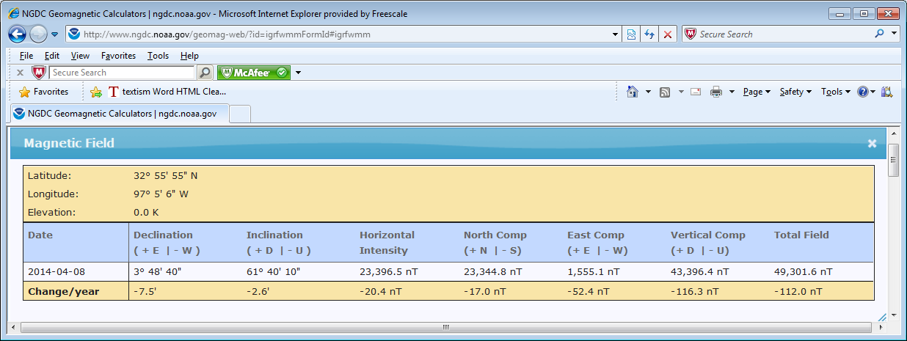
As an Aside...
horizontal intensity = 23.4μT
In Grapevine Texas, during the week of FTF2014, almost 2/3 of the earth’s magnetic field was directed DOWN

Slide 12
Adding a Pressure Sensor
This is a “10 axis” system
+Z = up
ω_{z}
+X
= East
Accelerometer
Gyro
Magnetometer
ω_{x}
Pressure
+Y
= North
ENU
ω_{y}
Pressure is a scalar (versus vector) quantity

Slide 13


Pressure Can Give You An Estimate Of Altitude
Altitude = K1 X (1 - (P/P0)^{K2})
K1 = 44330.77 meters
K2 = 0.190263 (unitless)
P0 = 101325 Pascals

Slide 14
Notice This Is A Log Scale...
This chart was created 2013, you can expect numbers to decrease over time.

Slide 15
Gyro ready to active = 2/ODR + 10ms
Now Try A Linear Scale...
Notice that the magnetometer currents are approximately 5X to 6X the accelerometer currents

Slide 16
Sensor Strengths & Weaknesses
Sensor | Strengths | Weaknesses
Accelerometer | Inexpensive Extremely low power Very linear Very low noise | Measures the sum of gravity and acceleration. We need them separate.
Magnetometer | The only sensor that can orient itself with regard to “North” Insensitive to linear acceleration | Subject to magnetic interference Not “spatially constant”
Gyro | Relatively independent of linear acceleration Can be used to “gyro-compensate” the magnetometer | Power hog Long startup time Zero rate offset drifts over time
Pressure Sensor | The only stand-alone sensor that can give an indication of altitude | Not well understood A “relative” measurement Subject to many interferences and environmental factors

Slide 17
Additional Observations
Accelerometers are the most power efficient motion sensor you’ll find
They often include motion detection circuits – use those to power the system up/down for idle periods
Accelerometers are low power because they are usually “passive” devices. The proof mass moves only when the device is in motion
Gyros have continuously moving proof masses, requiring much higher currents to keep them in motion
TMR1-based magnetic sensors are arranged in a Wheatstone bridge formation – requiring DC biases
Another good sensor to “gate” others is an ambient light sensor
¹ TMR = Tunneling MagnetoResistive

Slide 18
Sensor Types Required As Function Of Algorithm
Algorithm | Sensor Fusion IfDef | Pressure | Accelerometer | Magnetometer | Gyro
Altitude | F_1DOF_P_BASIC | X
Tiltmeter | F_3DOF_G_BASIC |  | X
2D Automotive Compass | F_3DOF_B_BASIC |  |  | X
Rotation | F_3DOF_G_BASIC |  |  |  | X
Tilt Compensated Compass | F_6DOF_GB_BASIC |  | X | X
Gaming Handset | F_6DOF_GY_KALMAN |  | X |  | X
Gyro Stabilized Compass | F_9DOF_GBY_KALMAN |  | X | X | X

Slide 19
What is the sensor fusion library used for?

Slide 20


What Is The Sensor Fusion Library Used For?
The primary output of the sensor fusion library is device orientation relative to a global frame of reference
Up
Body or Device Reference Frame
East
Earth Frame
North
The device orientation can be defined as the rotation necessary to map the global frame of reference into alignment with the body frame of reference (or vice versa).

Slide 21
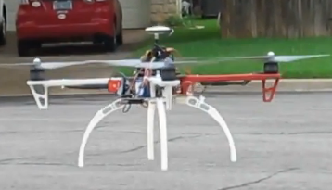




Why Is This Important?
Orientation is required for:
Gaming
Toys
Augmented Reality
Navigation / Location Based Services
Motion Control
UAV stabilization
Robots
Segway
Gun sights
Surveying
Human body tracking
Air mouse / TV remote control
Optical Image Stabilization
Context aware applications

Slide 22
Sensor Fusion Data Flow for Consumer Devices
Configure, Power State, Data Control
Sensor Hub Functions
Pressure
Trim
hi/low/band pass filtering
Pressure
Shake detection
shake event
3-Axis Acc
FoR mapping
Trim
hi/low/band pass filtering
Acc _{x,y,z}
3-Axis Gyro
FoR mapping
Trim
hi/low/band pass filtering
ω _{x,y,z}
3-Axis Mag
FoR mapping
Trim & Hard/Soft compensation
hi/low/band pass filtering
B _{x,y,z}
Raw data
calibration
parameters
Calculate hard/soft iron parameters
Kalman Filter or similar function
Geometric computations
Rotation matrix
Quaternion
Tilt-compensated mag heading
Orientation (φ, Θ, Ψ)
Sensor Fusion
FoR = Frame of Reference Mapping

Slide 23
NXP Sensor Fusion Version 7.00

Slide 24
Version 5.00 Versus Version 7.xx
Feature | Version 5.00 | Version 7.xx
Supported Algorithms | 3-axis tilt from magnetometer or accelerometer, 3-axis gyro rotation, eCompass, accel + gyro gaming and full 9-axis NXP Magnetic Calibration
GUI Support | Sensor Fusion Toolbox for Windows Sensor Fusion Toolbox for Android
Packaging | Standalone | Bundled with the ISSDK, which is Integrated into the MCUXpresso SDK
Code Generator | Processor Expert | N/A
Toolsets | CodeWarrior Kinetis Design Studio | Kinetis Design Studio, IAR, ARM GCC, Atollic and (soon) MCUXpresso
Boards supported “out of the box” | KL25Z, KL26Z, KL46Z, K20D50M, K64F | K22F, K64F¹
RTOS or Bare Metal | MQXLite only | FreeRTOS or Bare Metal
Magnetic Calibration | Separate background thread | Serialized to run in fusion thread
¹ A KL25Z port is available on the community, and Mike has a private port for K66F

Slide 25
Magnetic Calibration Tradeoffs Between V5.00 And V7.Xx Sensor Fusion
Feature | V5.00 and earlier | V7.00
Accuracy | Same algorithms used for both
Startup time | A few seconds | Slower if coefficients have to be computed every time. Instantaneous if NVM storage is used for pre-computed coefficients.
Implementation | Required background thread | Not even visible to most programmers

Slide 26
Version 5.00 Versus Version 7.xx
Feature | Version 5.00 | Version 7.xx
Programmable sampling and fusion rates | YES | YES
3- Clause BSD license | YES | YES
Nonvolatile storage of Magnetic Calibration and Trim parameters | No | YES
Includes Precision Accelerometer Trim | No | YES
Lower power option available | No | YES
Support for sensor FIFOs and multi-rate sensor sampling | No | YES

Slide 27
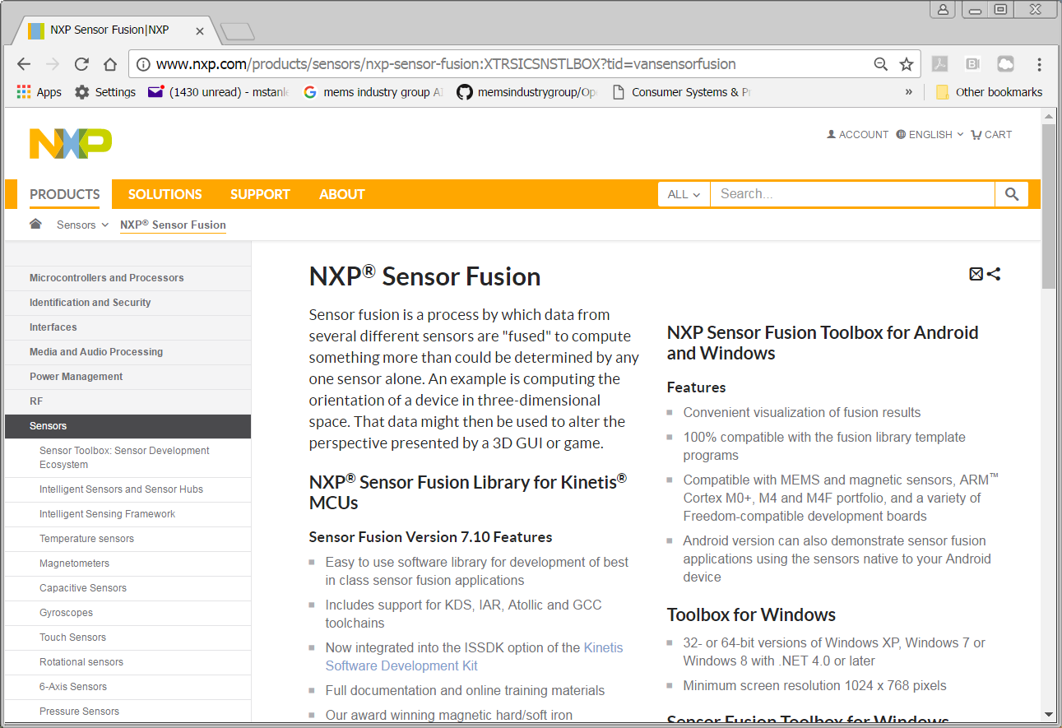
http://www.nxp.com/sensorfusion

Slide 28
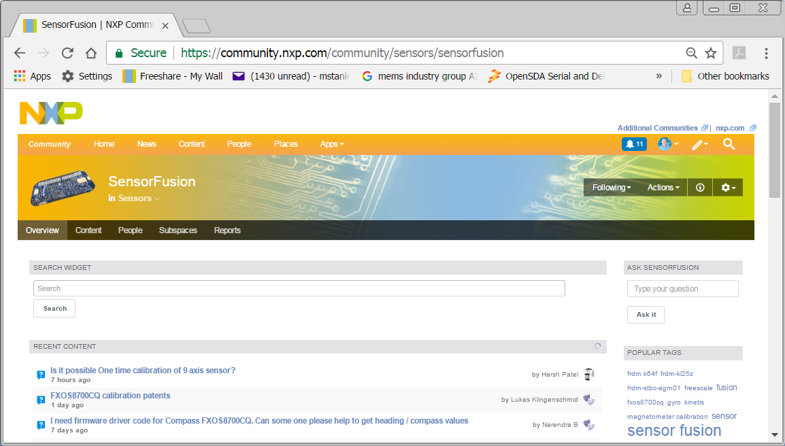
Community Support for Sensor Fusion
https://community.nxp.com/community/ sensors/sensorfusion

Slide 29
Supported Hardware and how to get it

Slide 30
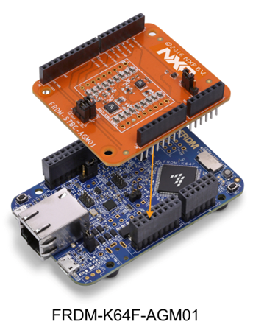
Required Hardware for V7.00 Sensor Fusion
FRDM-K22F or FRDM-K64F
FRDM-STBC-AGM01 or FRDM-MULT2-B Sensor Shield
A USB to μUSB cable
A PC running Windows

Slide 31
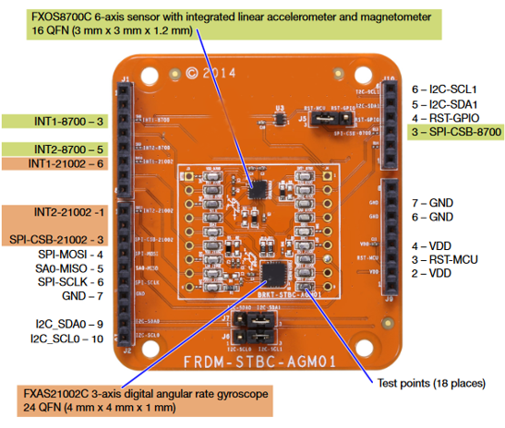
FRDM-STBC-AGM01 Sensor Shield

Slide 32
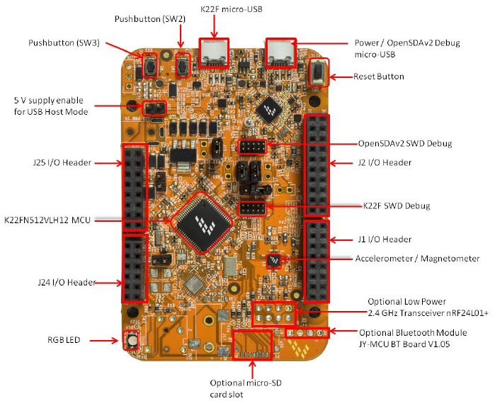
FRDM-K22F Freedom Development Platform

Slide 33
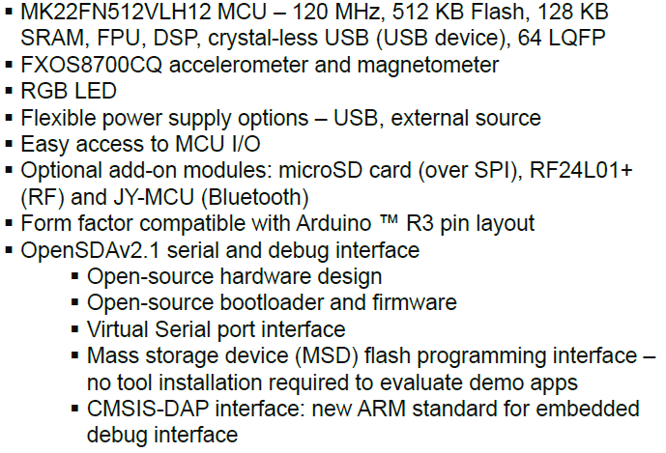
FRDM-K22F Features

Slide 34
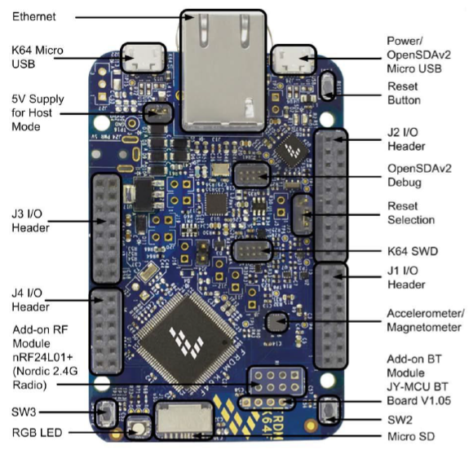
If You Have A FRDM-K64F

Slide 35

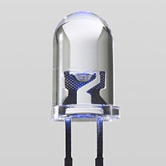
Open SDA
OpenSDA
GPIO
PWM
OpenSDA MCU
Kinetis® K2x
Target
Processor
MSD Bootloader
USB Host
IDE
File System
Serial Terminal
GPIO / ADC
UART TX/RX
SPI, GPIO
nRESET
UART RX/TX
SWD/JTAG
USB
OpenSDA Application
“OpenSDA is a serial and debug adapter that is built into NXP® evaluation boards. It provides a bridge between your computer (or other USB host) and the embedded target processor, which can be used for debugging, flash programming, and serial communication, all over a simple USB cable.”

Slide 36
OpenSDA Resources
http://nxp.com/opensda START HERE
https://www.segger.com/opensda.html
http://www.pemicro.com/opensda/
https://developer.mbed.org/handbook/Windows-serial-configuration
You must have Windows drivers installed to support your chosen implementation of OpenSDA. They can be obtained from the links above.
Each implementation varies in terms of supported features.
My personal preference is Segger’s, for speed of download, although it does lack drag and drop programming.

Slide 37

http://www.nxp.com/freedom

Slide 38
Sensor Fusion Toolbox for Windows

Slide 39
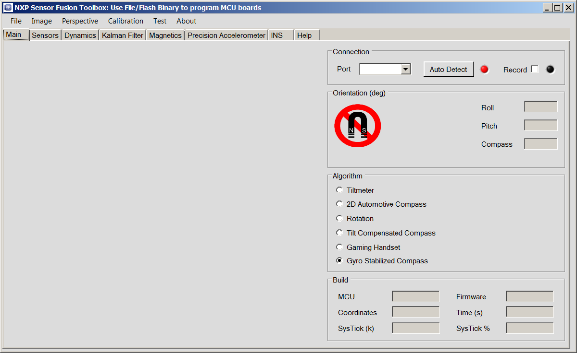
Sensor Fusion Toolbox for Windows

Slide 40
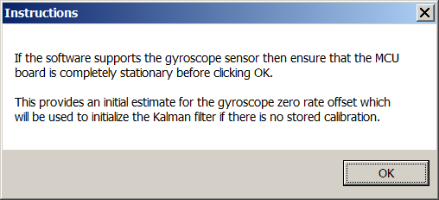
Put Your Board Flat On The Table When Starting Up

Slide 41
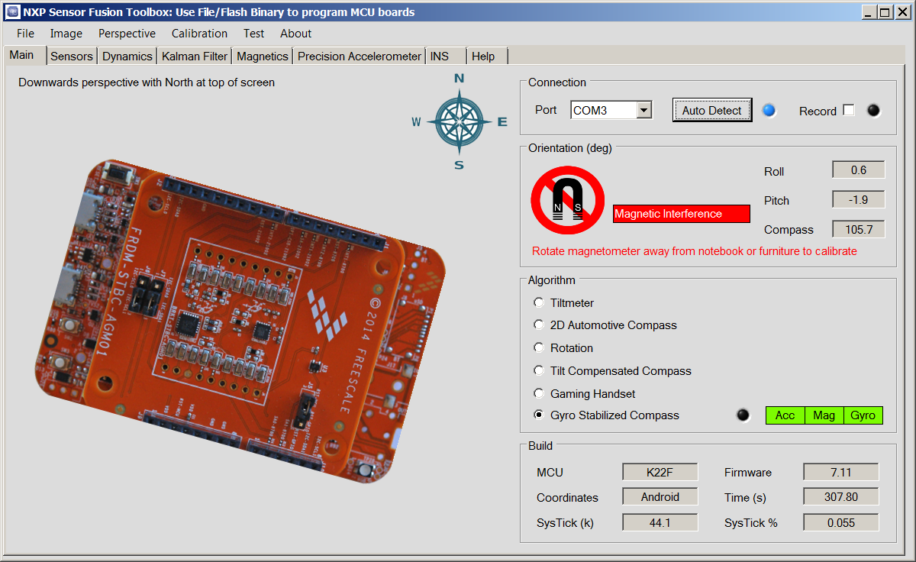
Time To Wave The Board Around

Slide 42
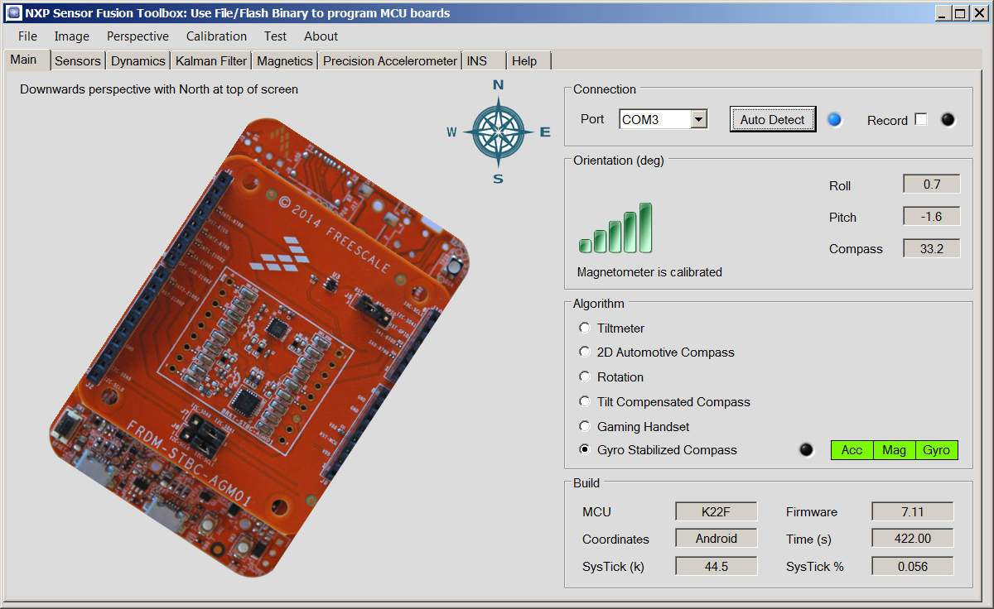
Now Have Magnetic Calibration

Slide 43
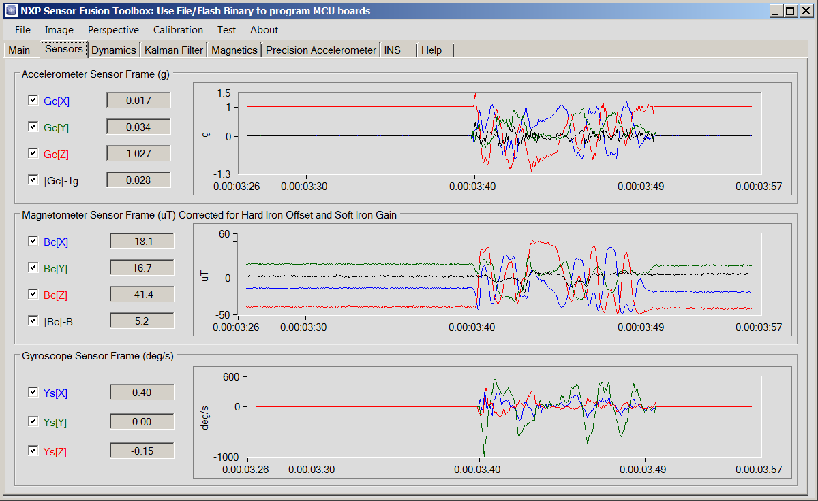
Sensors Tab

Slide 44
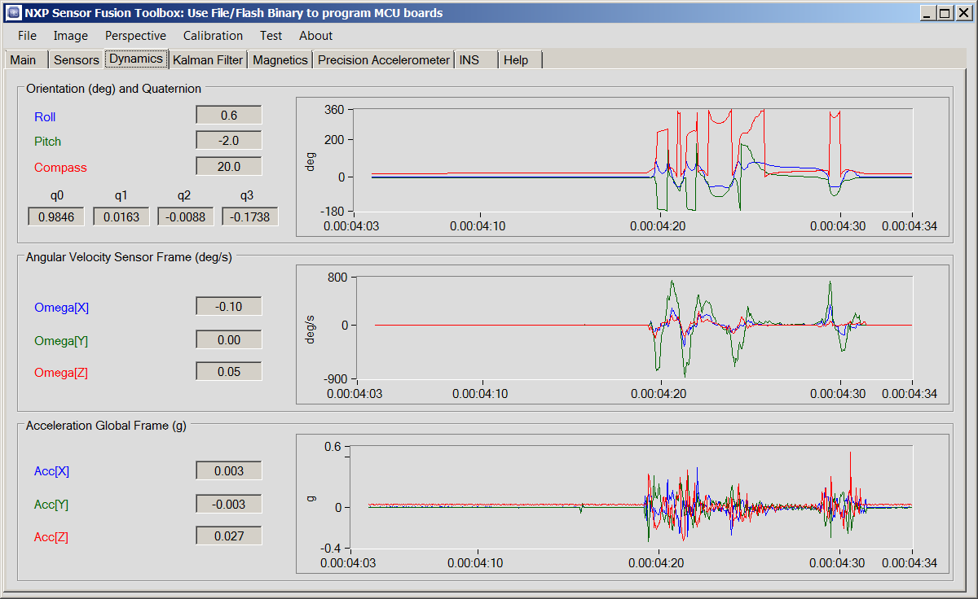
Dynamics Tab

Slide 45
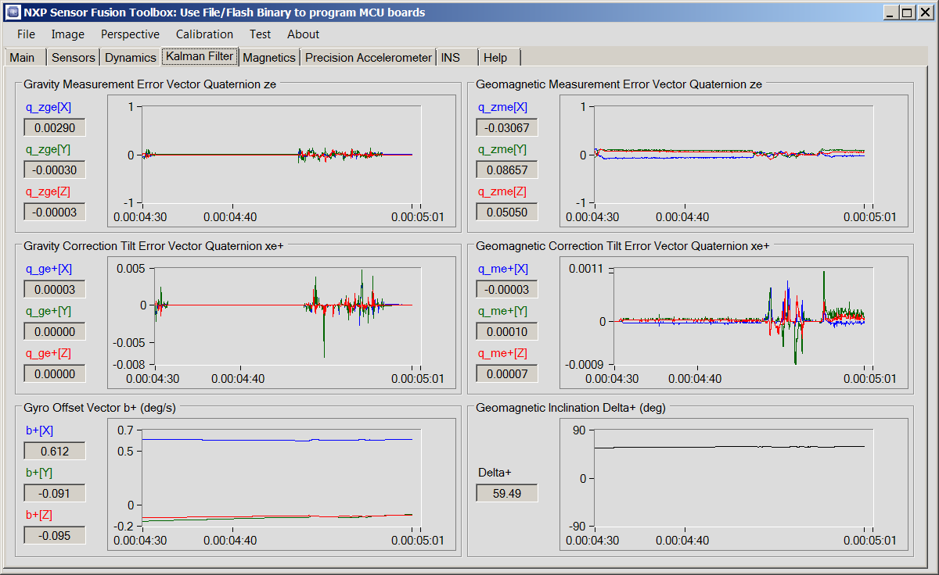
Kalman Filter Tab

Slide 46
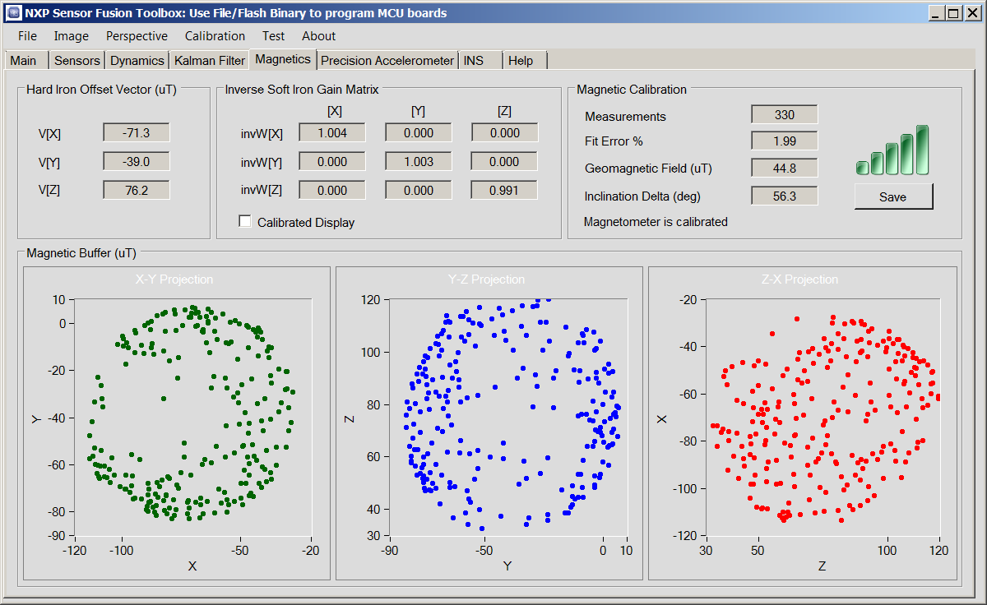
Magnetics Tab

Slide 47
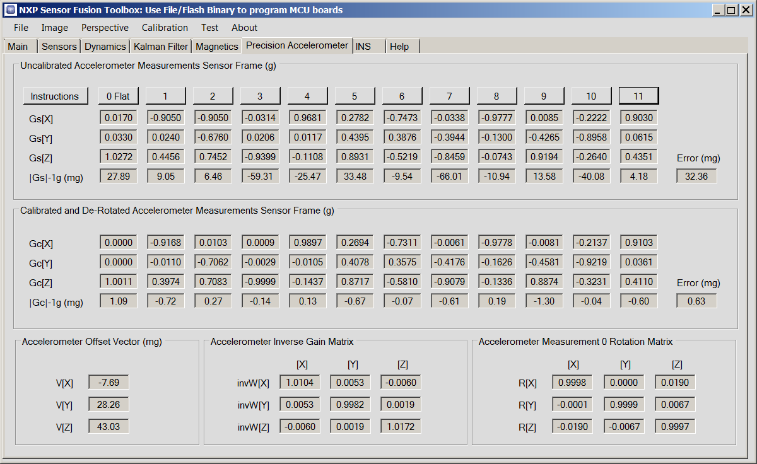
Precision Accelerometer Tab

Slide 48
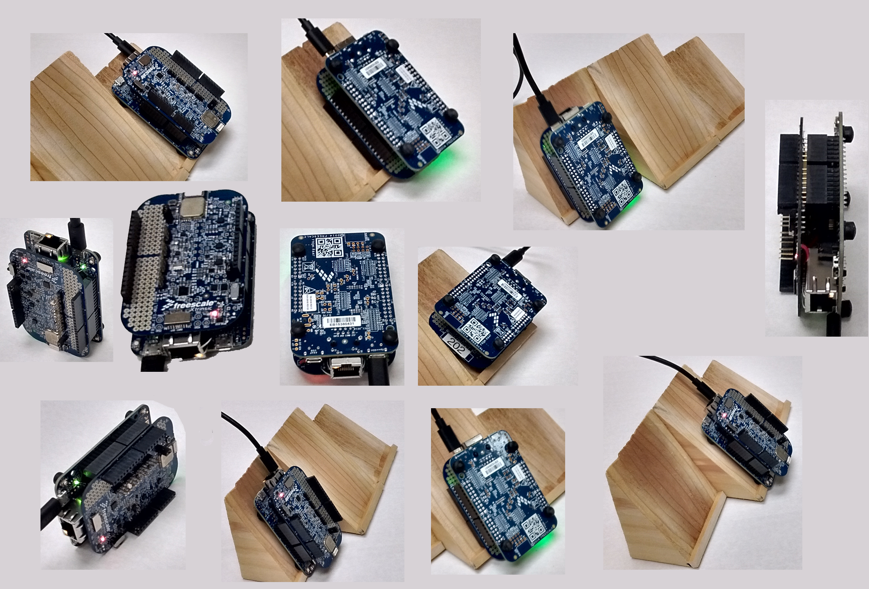
Precise Control Of Measurement Angles Is Only Required Once: Flat

Slide 49
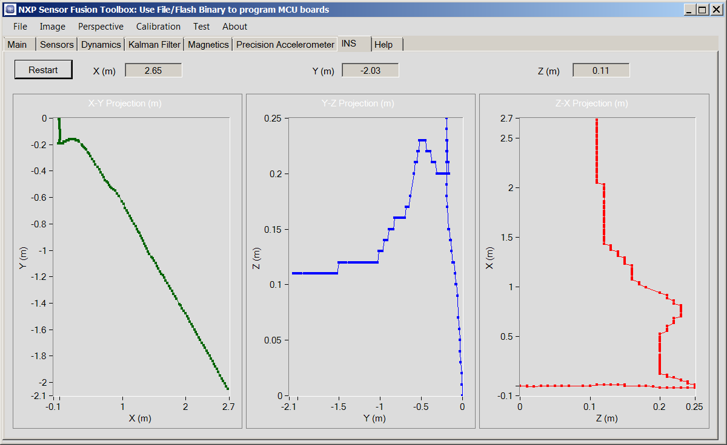
Inertial Navigations Systems Tab

Slide 50
Sensor Fusion Toolbox for Android

Slide 51

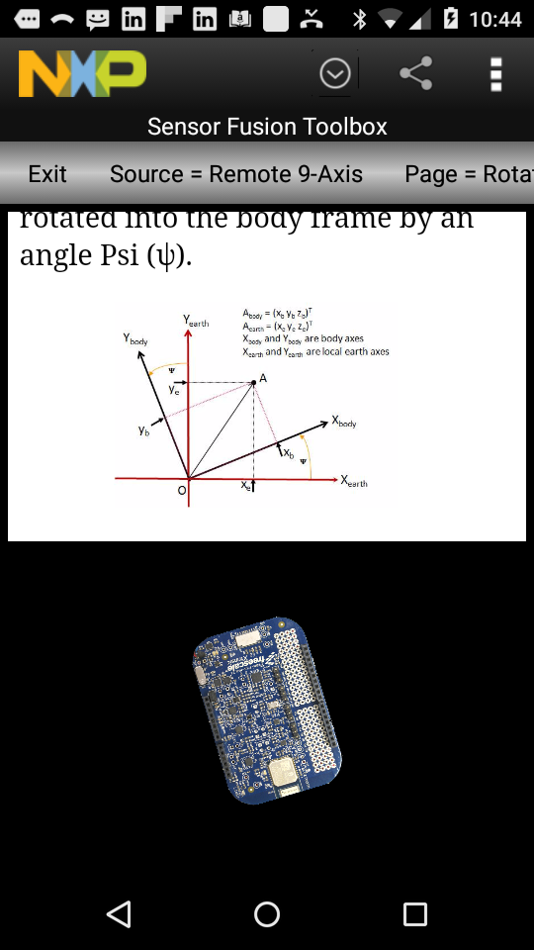
Sensor Fusion Toolbox for Android
Requires a FRDM-MULT2-B sensor shield or other Bluetooth adapter.

Slide 52

Download it Using Google Play
Search for “Sensor Fusion”
Choose the version with the NXP Logo

Slide 53
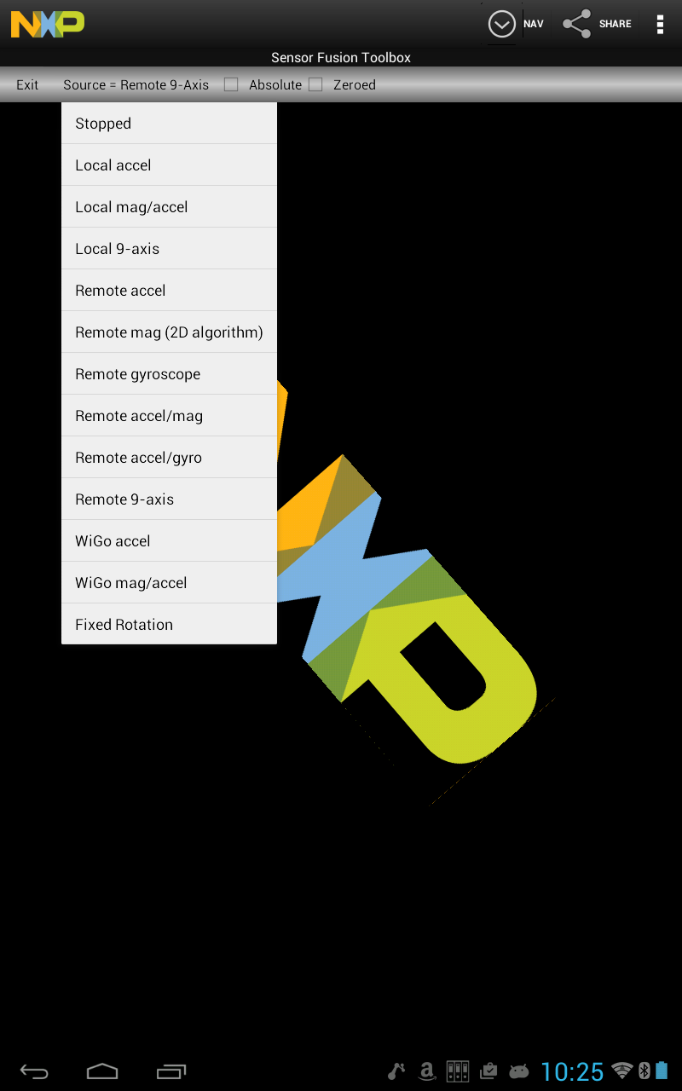
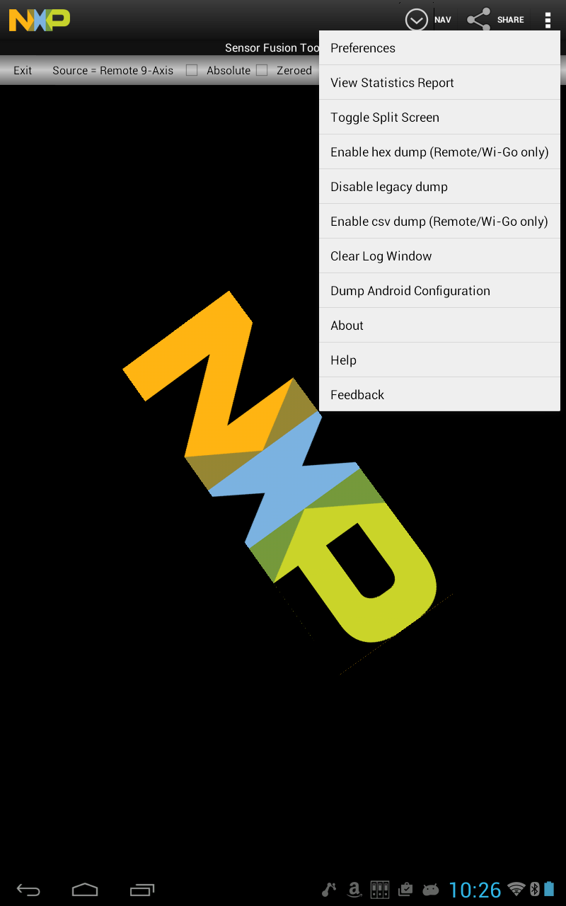
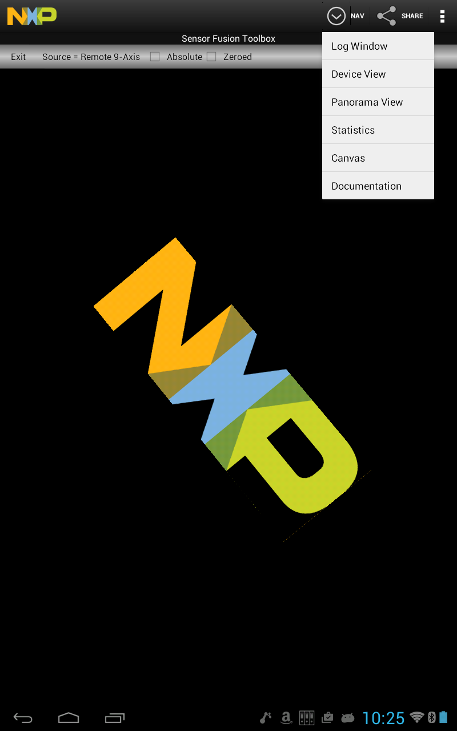
Navigating the Android GUI
The “Sources” Menu
The “Options” Menu
The “Navigation” Menu

Slide 54
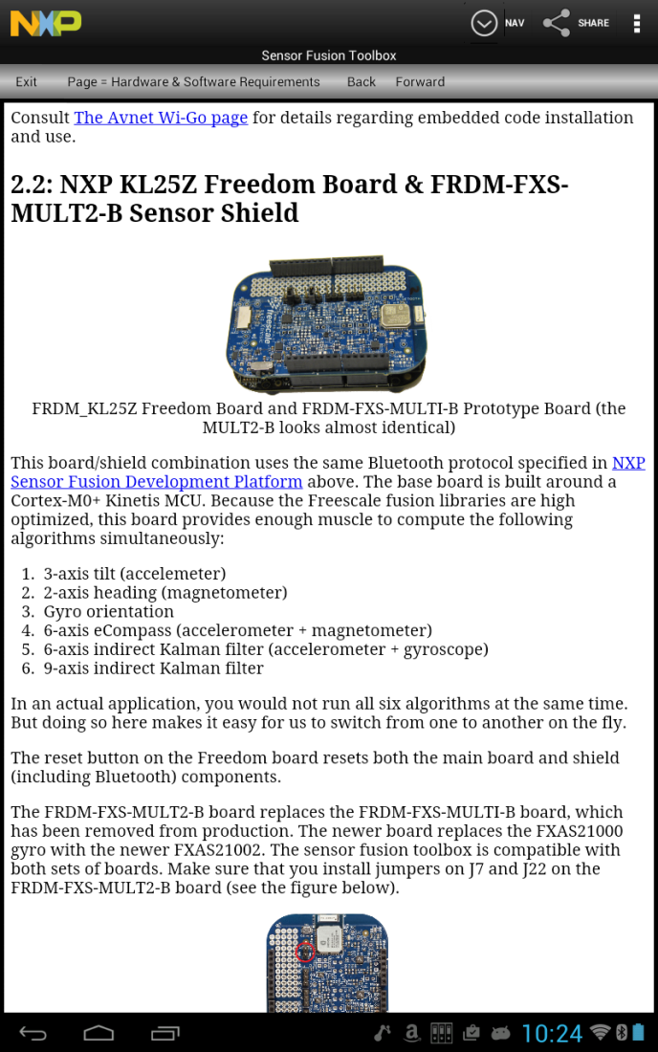
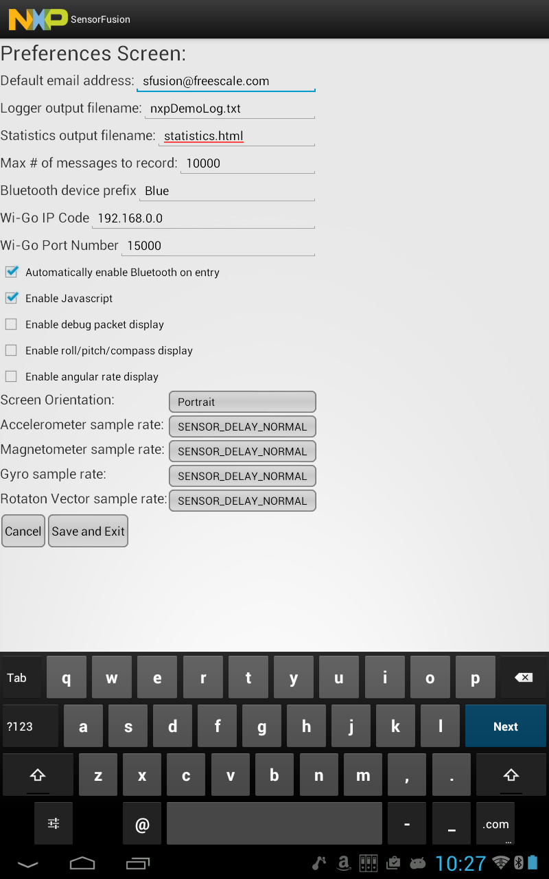
More Utility Functions
In-App Documentation
Setting Preferences

Slide 55
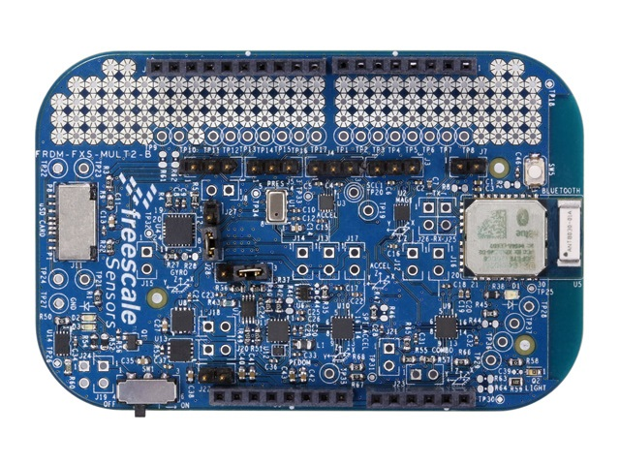
If You Are Using A FRDM-MULT2-B Board
Make sure you check “Automatically enable Bluetooth on entry in the Preferences screen.
Make sure you have a jumper installed at “A”
The last few digits of the BlueRadios Bluetooth object name can be read on the module at “B”
B
A

Slide 56
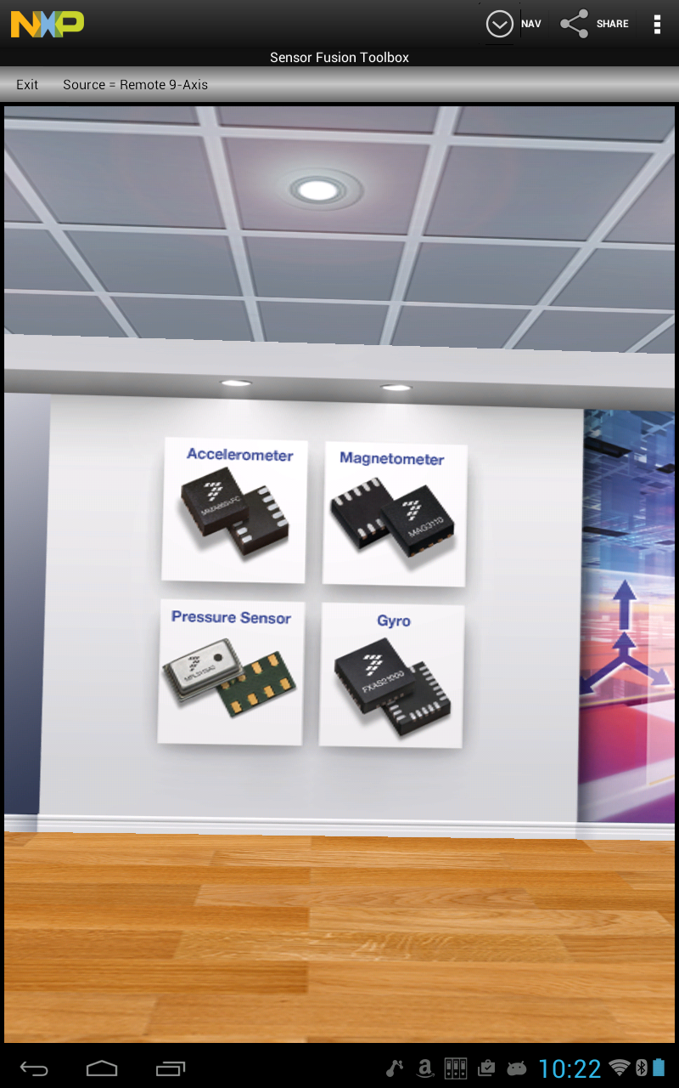
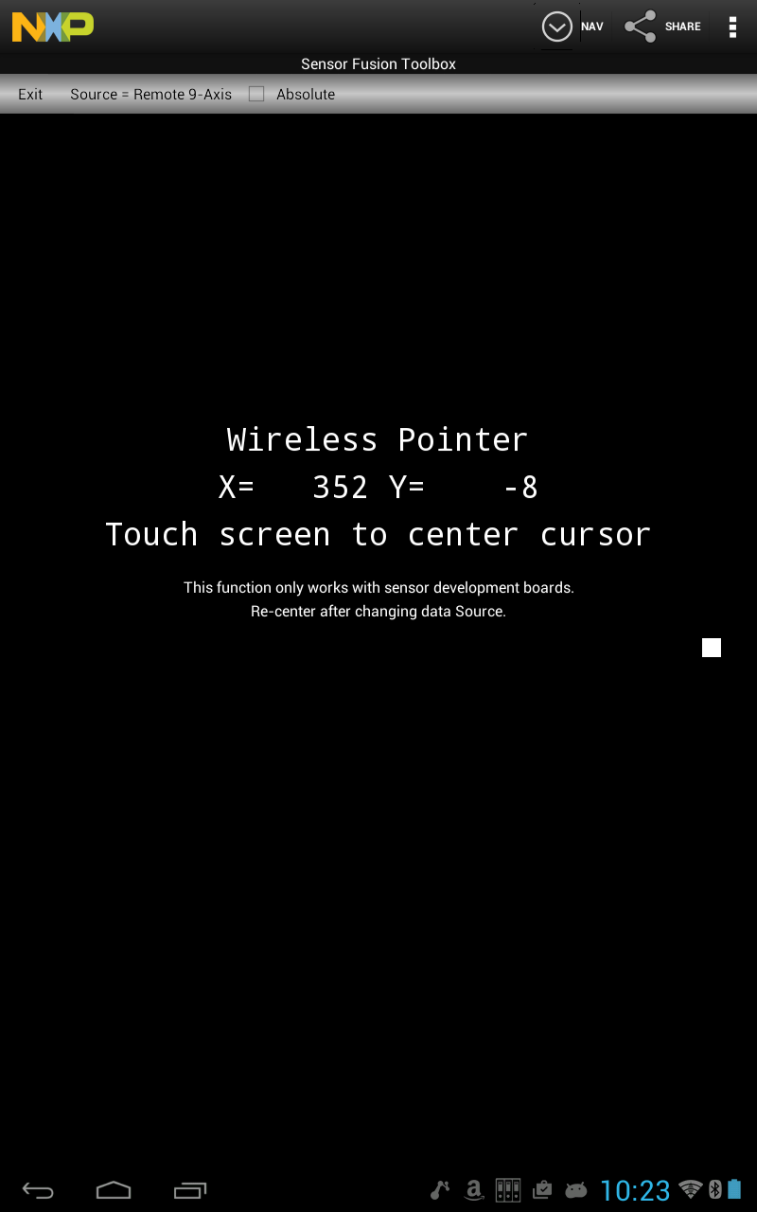
Sample Applications
Virtual room view responds to both board and phone orientations
Experiment with an air mouse / pointer

Slide 57
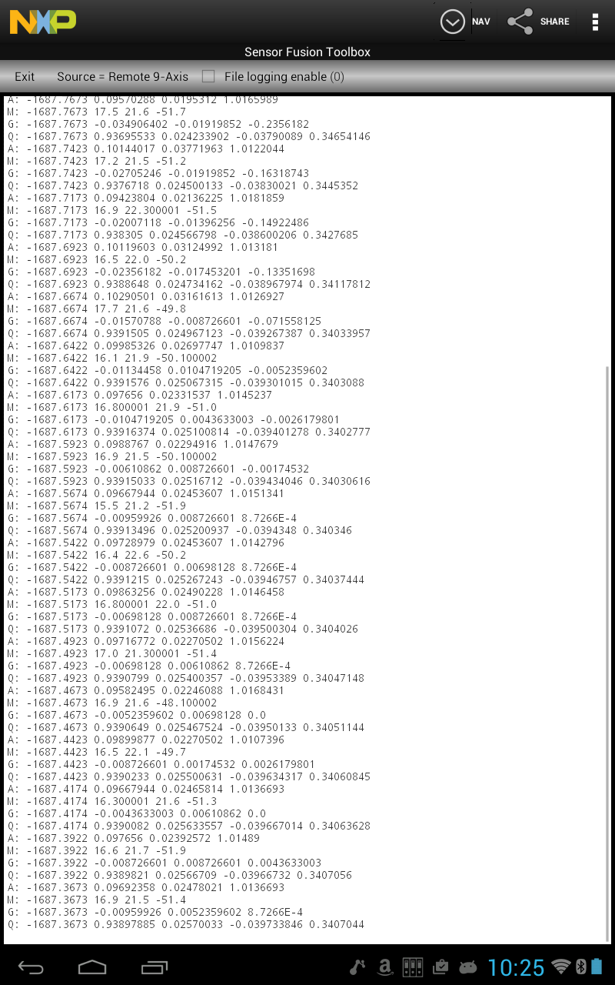
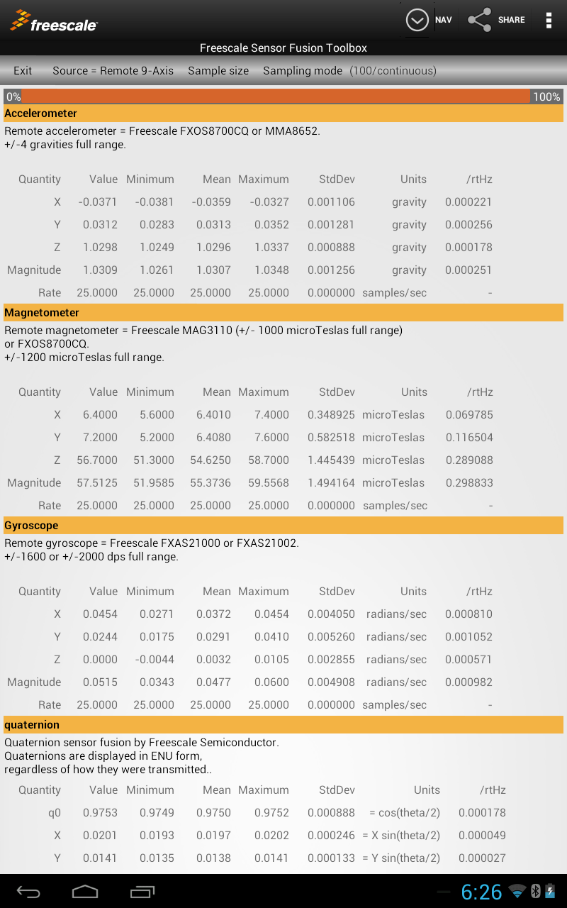
Data Collection
Data Logging
Real-Time Statistics

Slide 58
The Freescale Sensor Fusion Toolbox Features by Platform
Feature | Android | PC
Bluetooth wireless link | ⎫ | Requires BT on PC (built-in or dongle)
Ethernet wireless link | On WiGo board only | -
UART over USB | - | ⎫¹
OS requirements | >= Android 3.0 | >= Windows 7.0
Support for native sensors | ⎫ | -
Advanced Calibration | - | ⎫
Device View | ⎫ | ⎫
Panorama View | ⎫ | -
Statistics View | ⎫ | -
Canvas View | ⎫ | -
Orientation XY Plots | - | ⎫
Inertial XY Plots | - | ⎫
Magnetics | - | ⎫
Kalman | - | ⎫
Altimeter XY Plots | - | ⎫
Data Logging Capability | ⎫ | ⎫
Integrated documentation | ⎫ | ⎫
Availability | Google Play | Freescale website
Price | Free | Free
¹ FRDM_K64F and FRDM_K20D50M projects require a Processor Expert configuration change to run in wired mode.

Slide 59
Using the MCUXpresso Config Tools to generate a Version 7.00 sensor-fusion enabled SDK

Slide 60
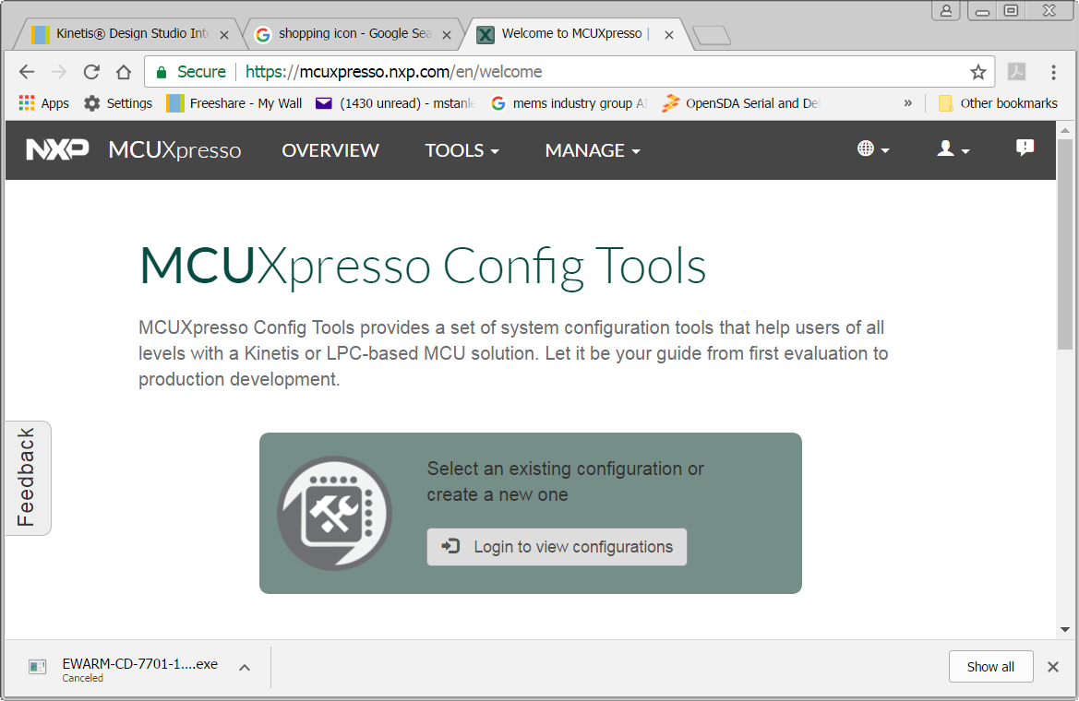
Getting the KSDK - https://mcuxpresso.nxp.com

Slide 61
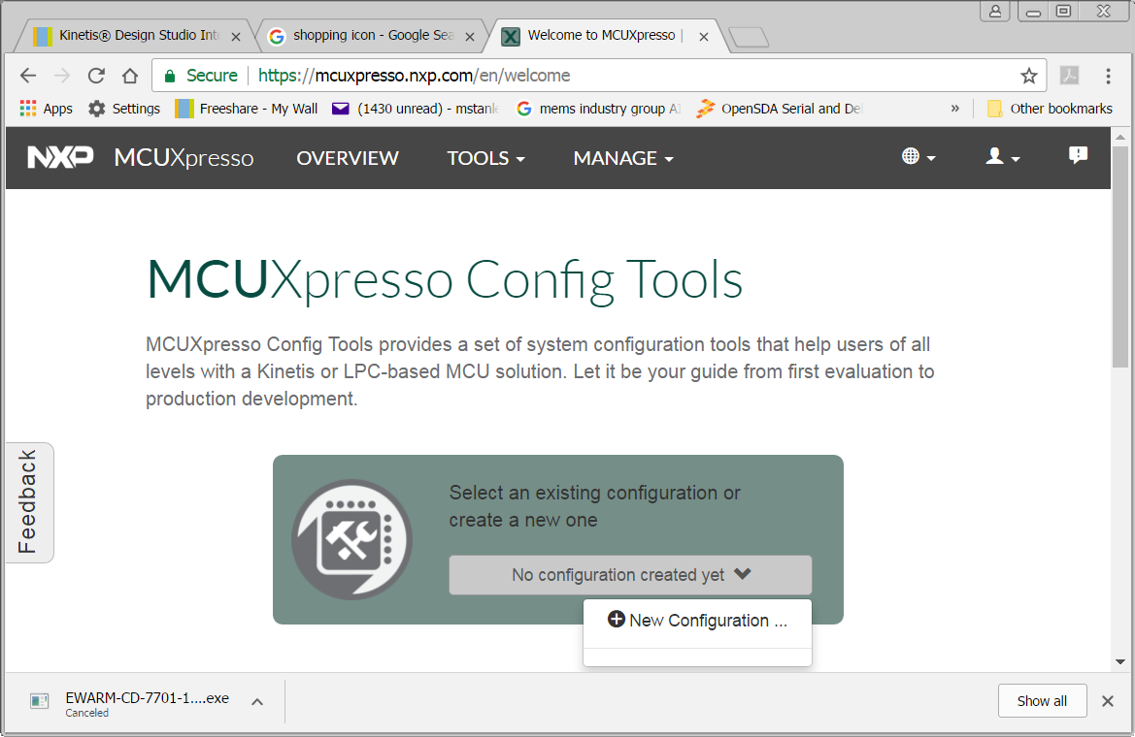
Create a New Configuration

Slide 62
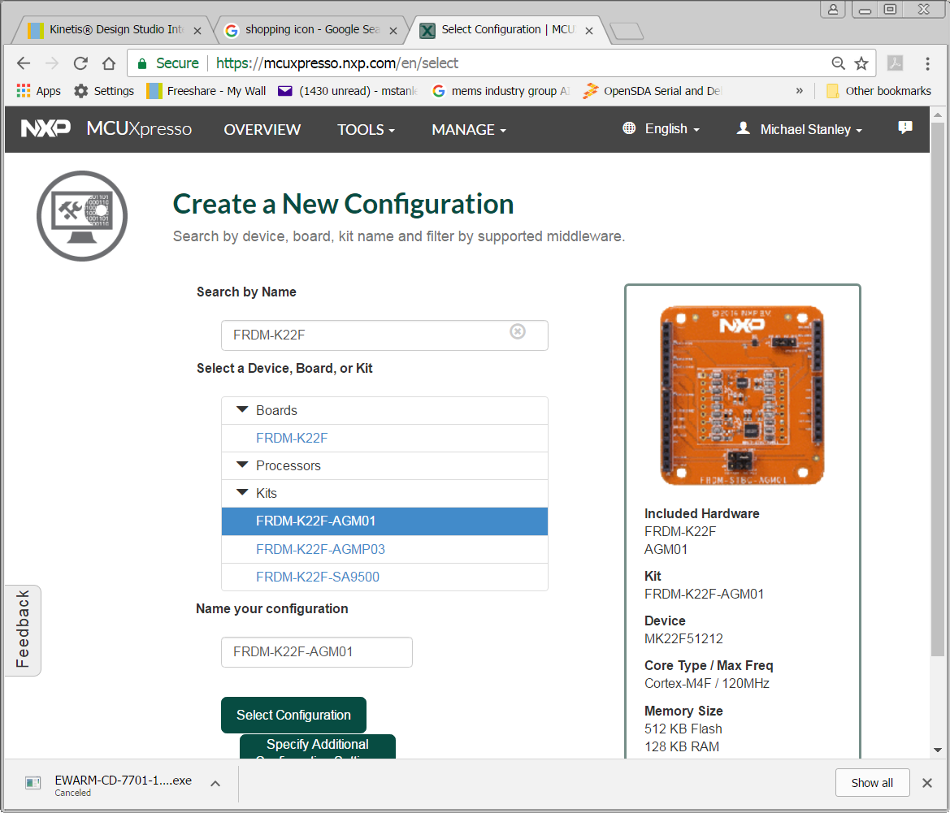
Search for your board

Slide 63
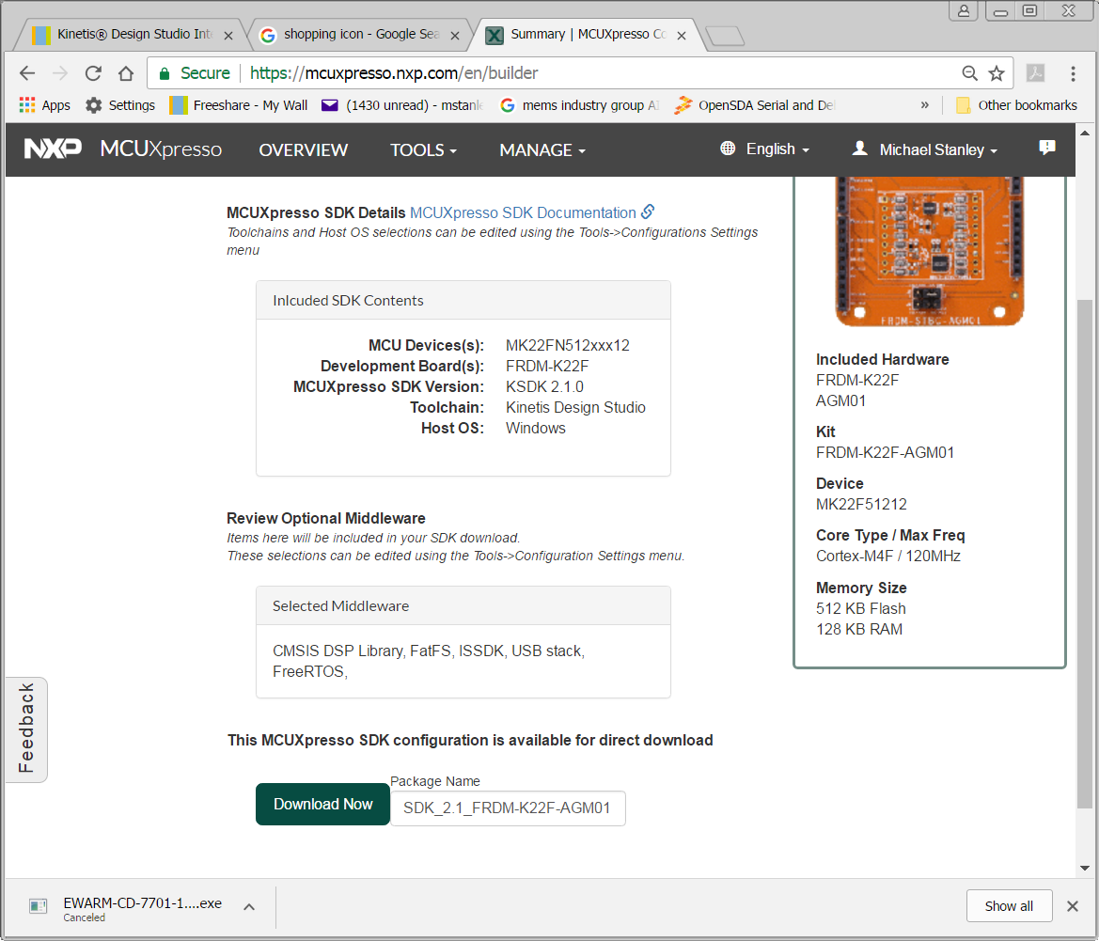
Click here and follow the prompts

Slide 64
Hint
When you install your SDK, do not install it deep within a file hierarchy. Apparently KDS has problems with long path names.

Slide 65
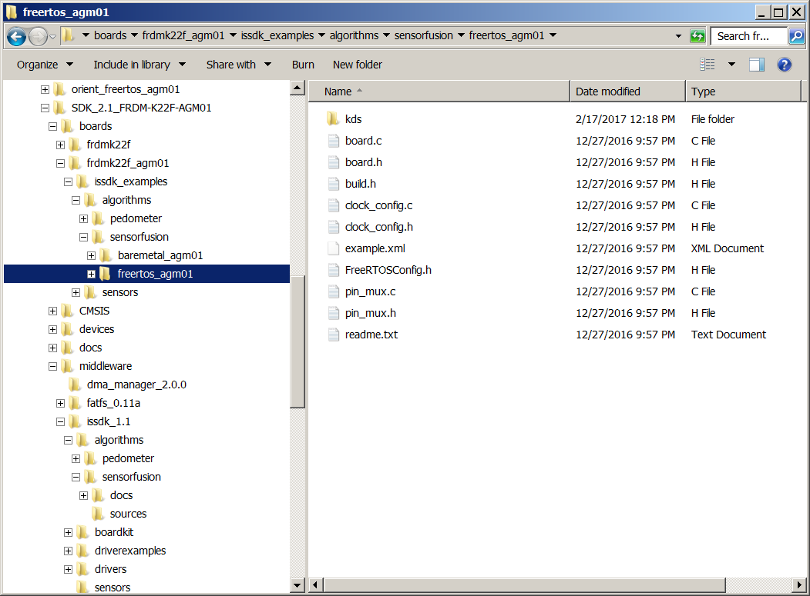
After Downloading And Expanding The SDK
Additional tool options are available when you configure the SDK download

Slide 66
Supported development tools and how to get them

Slide 67
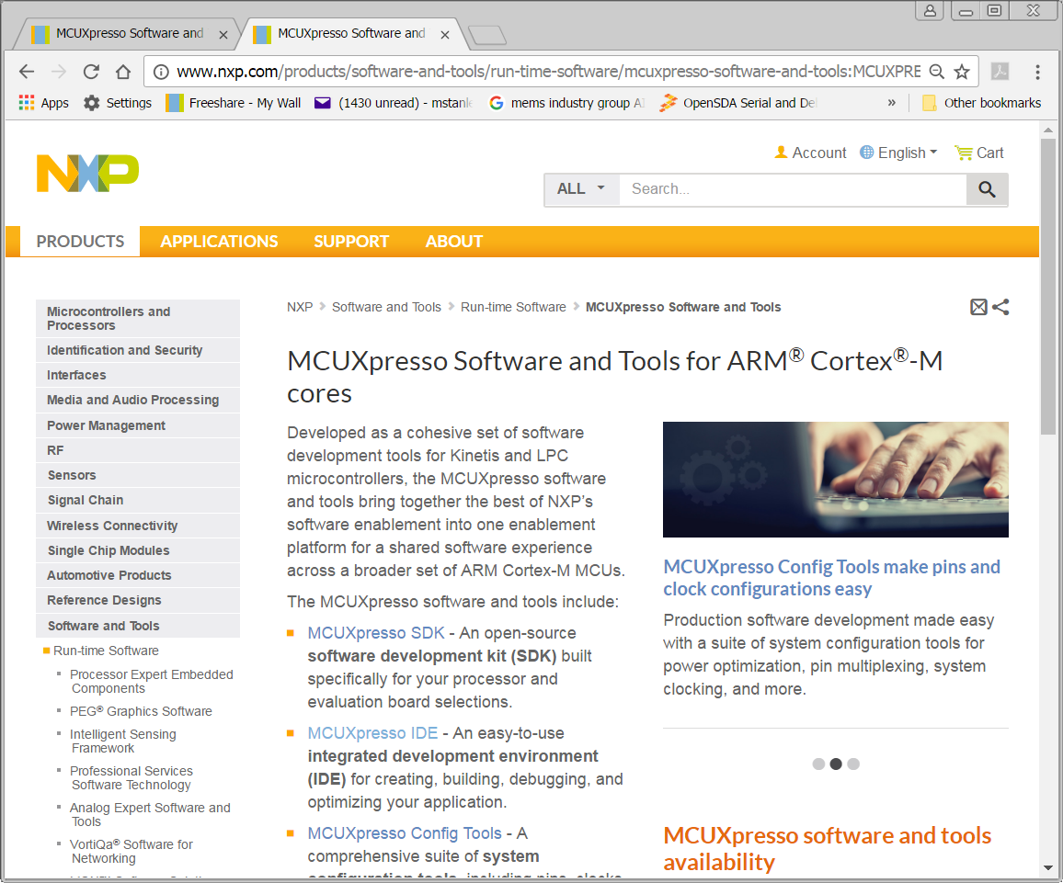
http://www.nxp.com/mcuxpresso

Slide 68
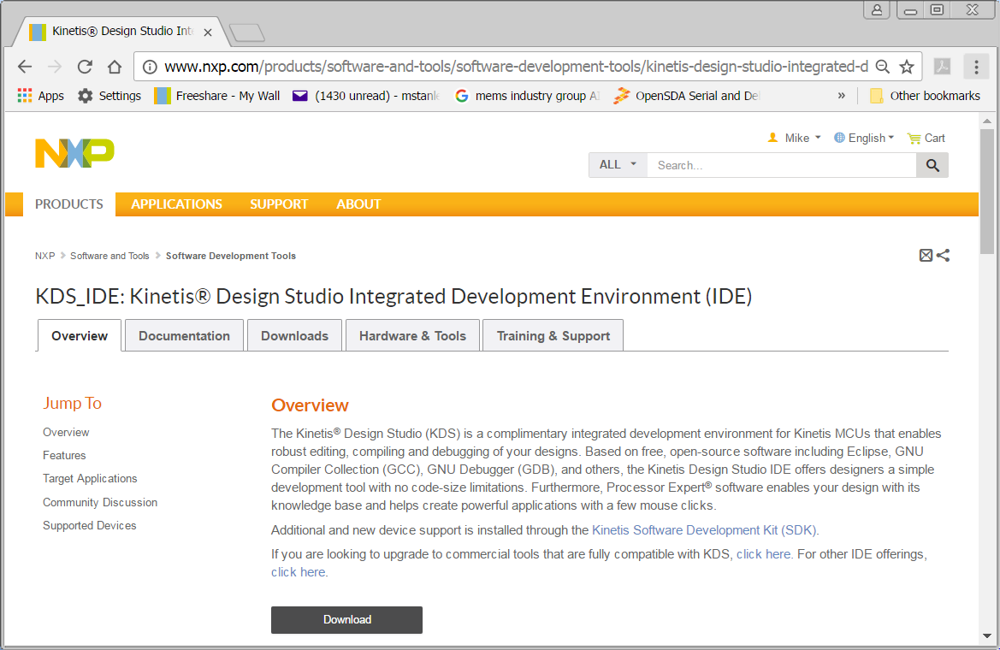
Kinetis Design Studio : http://www.nxp.com/kds

Slide 69
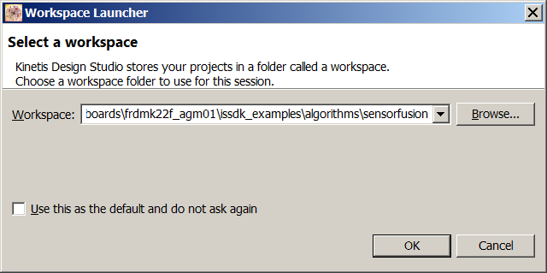
When Invoking KDS, You Will Be Asked To Select A Workspace
Example pathname: <SDK root> /boards /frdmk22f_agm01 /issdk_examples /algorithms /sensorfusion

Slide 70

Close The Welcome Screen

Slide 71
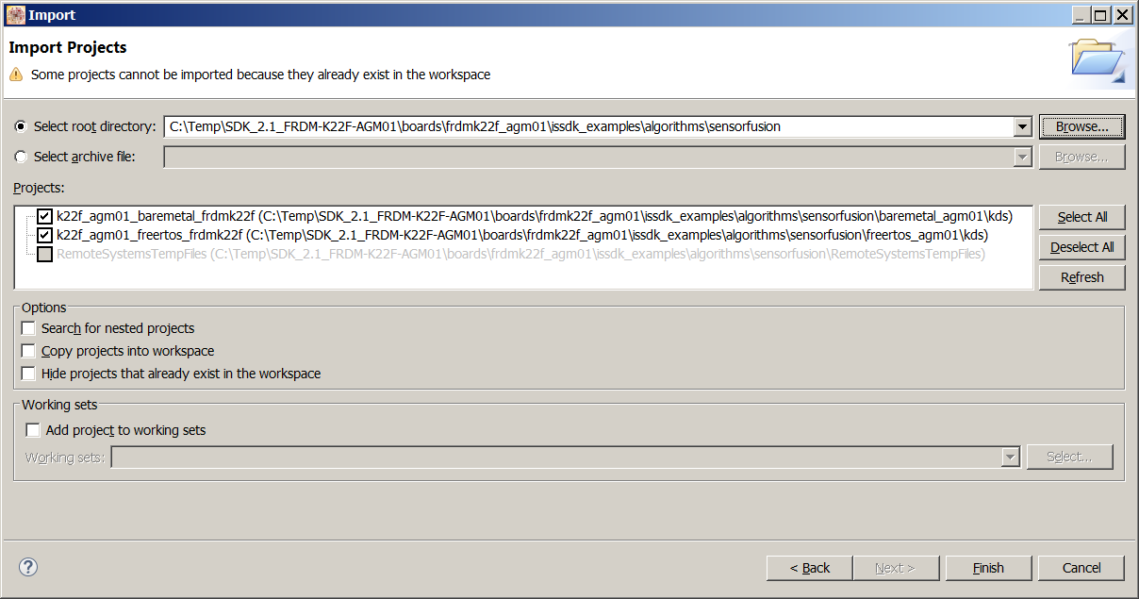
File->Import->Existing Projects Into Workspace

Slide 72
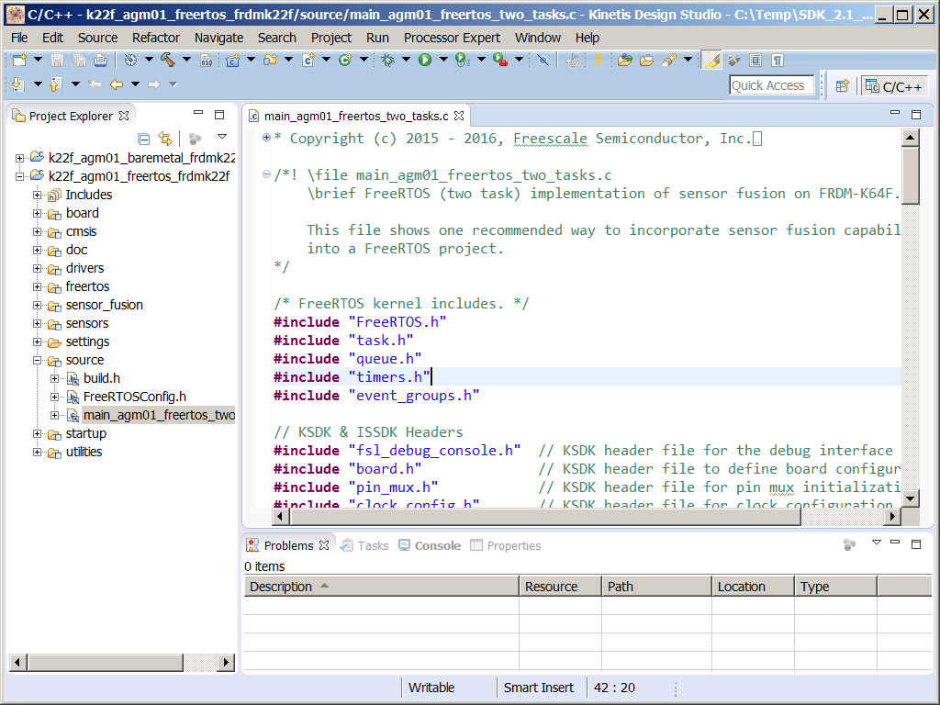
You Can Now Double Click On One Of The Projects To Open It.

Slide 73
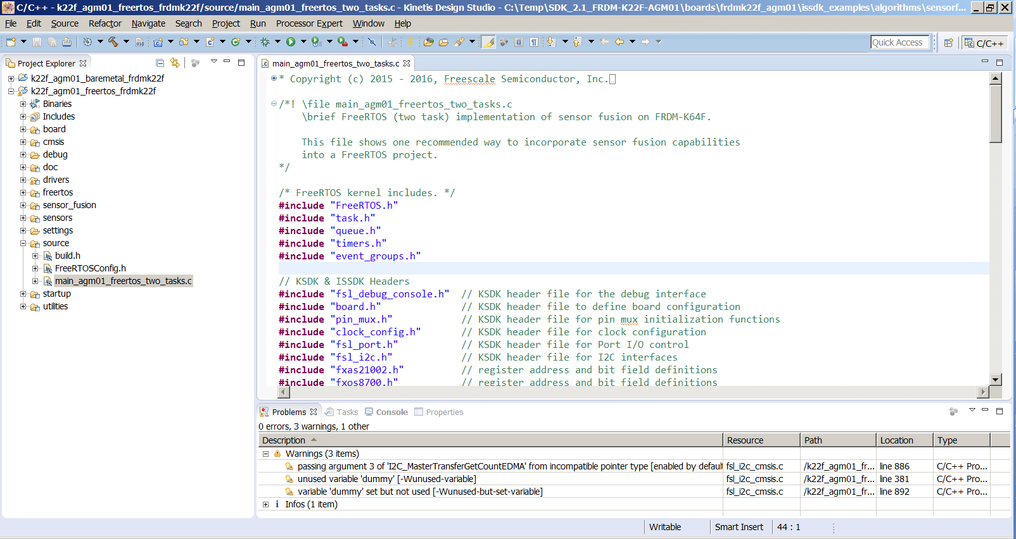
After Clicking The Hammer Icon To Build, You May Have A Few Warnings…

Slide 74
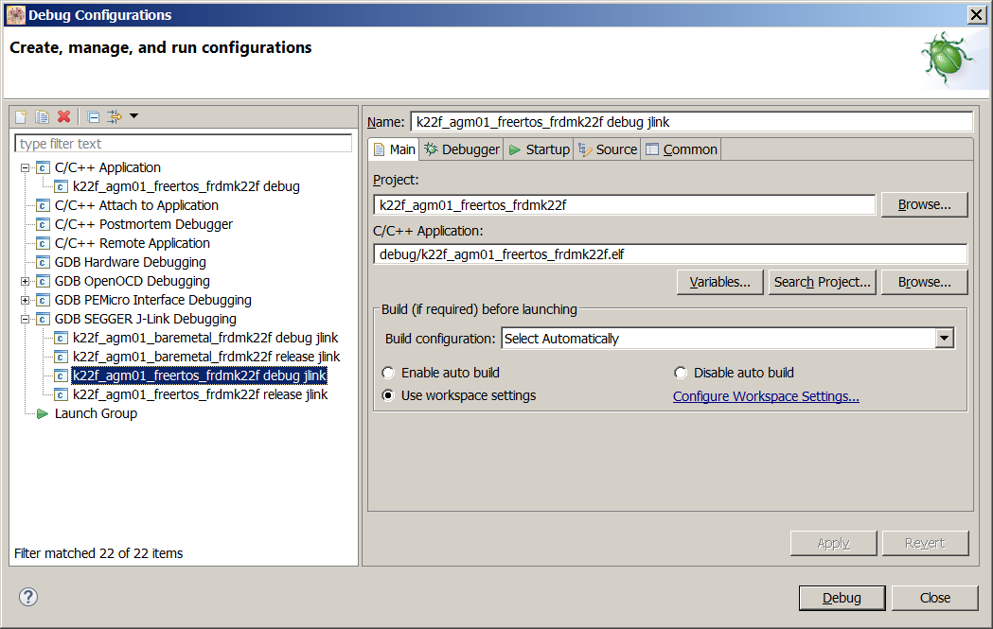
Run->Debug Configurations
You need to tell KDS what OpenSDA implementation you are using.
Here, I am using Segger jlink

Slide 75
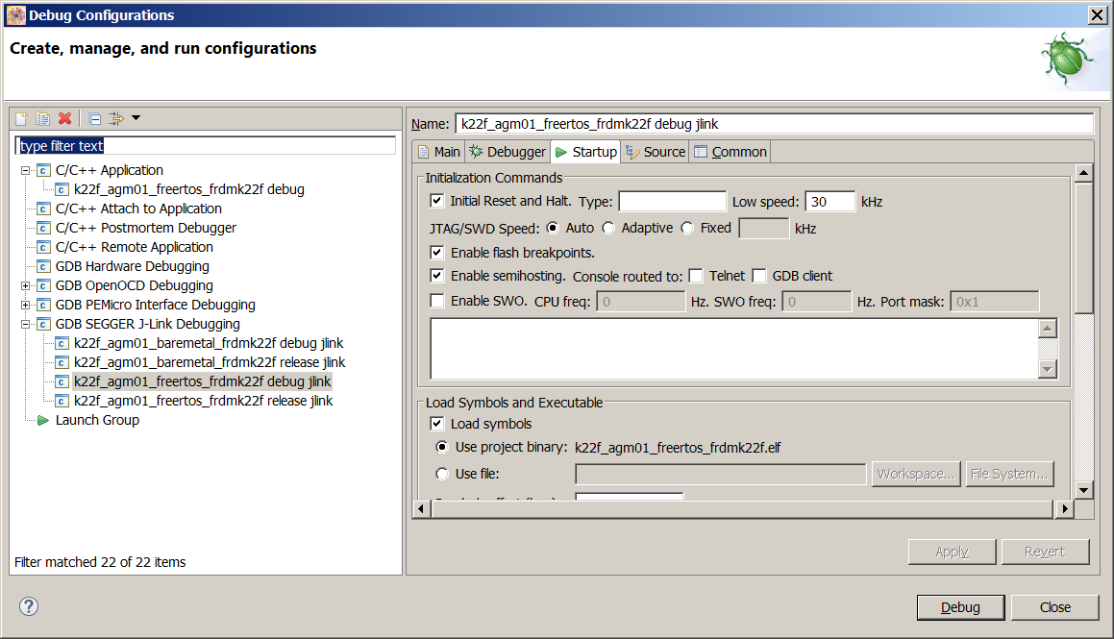
Uncheck The “Enable SWO” Checkbox On The Startup Tab. Then Click The “Debug” Button

Slide 76
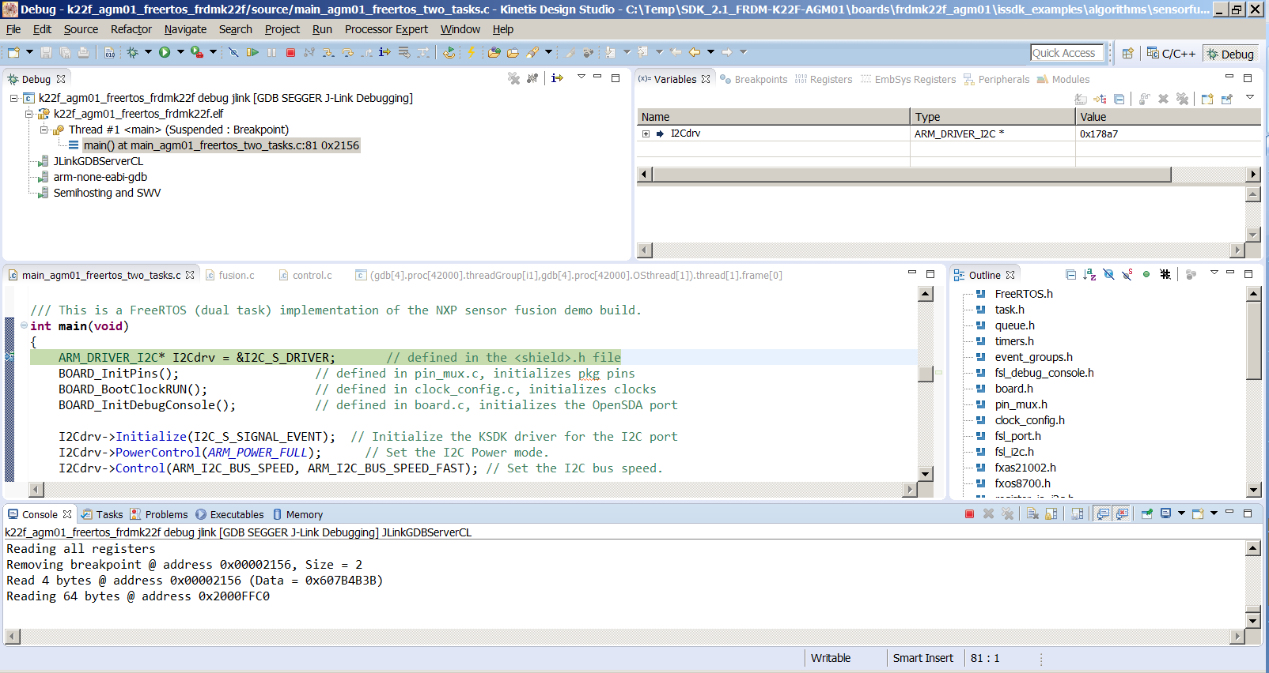
Your Program Has Been Downloaded , Is Paused At The Start Of Execution And Is Ready To Run/Debug

Slide 77
Version 7.xx sensor fusion library structure

Slide 78
NXP Sensor Fusion for Kinetis MCUs Verson 7.xx
Application-specific bare metal or RTOS-based main()
Sensor Fusion Core Functions
initSensor FusionGlobals()
install Sensor()
initialize Fusion Engine()
read Sensors()
condition Sensor Readings()
runFusion()
The KSDK is available to main as well
Status SubSystem
Control SubSystem
Intelligent Sensor SDK
NonVolatile Storage
Board specific Hardware Abstraction Layer
GPIO
UART
I²C / SPI
Flash Memory
KSDK = Kinetis Software Design Kit

Slide 79
Primary Subsystems and Associated Peripherals
Subsystem | Required | Peripherals Required | Comments
Main | Yes | Timer | PIT or similar if bare metal; SysTick commonly used for RTOS
Control | Debug minimum | UART | Example projects utilize two, one for OpenSDA wired connections, one for Bluetooth.
Status | No | Tri-Color LED
ISSDK | Yes | I²C and/or SPI | As required by the specific set of sensors used

Slide 80
Example: FRDM-K64F And FRDM-FXS-MULT2-B / Peripheral Assignments
Subsystem | Function | Suggestion | Comments
Bare-metal main | Timer | PIT0 | Encapsulated in driver_pit.c/.h
FreeRTOS main | Timer | SysTick | Possible interaction with Sensor Toolbox metrics measurement
Control | UART | UART3 on PTC17:16 | Connects to Bluetooth module on sensor shields
 |  | UART0 on PTB17:16 | Connects to OpenSDA CDC (UART/USB) on the Freedom board
Status | Red LED | PTB22
 | Green LED | PTE26
ISSDK | I²C | I²C0 on PTC11:10 | All I²C sensors on FRDM-FXS-MULT2-B (excluding the FXLS8471Q)
 | Accel/Mag | FXOS8700 | I²C address 0x1E on the FRDM-FXS-MULT2-B
 | Gyro | FXAS21002 | I²C address 0x20 on the FRDM-FXS-MULT2-B
 | Altimeter | MPL3115A2 | I²C address 0x60 on the FRDM-FXS-MULT2-B

Slide 81
Observations
The status and control subsystems are available to both the sensor fusion core and customer functions.
Everything is coded in C, but with a top level organization that could easily be recast into C++ in the future.
The sensor fusion core is (with the possible exception of some covariance numbers) completely hardware independent.
There are no low level procedural interfaces, you just look up sensor fusion outputs from standard global locations.

Slide 82
IDE Road trip- Pause here to interactively review a project

Slide 83
Sensor Fusion File Structure Within the SDK
SDK_2.1_FRDM-K22F-AGM01
frdm_k22f.c / .h
boards
frdm_stbc_agm01_shield.h
Issdk_hal.h
frdmk22f_agm01
middleware
Issdk_examples
Issdk_1.1
algorithms
baremetal_agm01
algorithms
sensorfusion
freertos_agm01
sensorfusion
docs
build.h
sources
FreeRTOSConfig.h

Slide 84
Various gory details

Slide 85
What To Look For In The Sources Directory
Filenames | Descriptions
approximations.c / .h | Contains custom trig functions optimized for performance
calibration_storage.c / .h | Functions for storing and retrieving trim parameters to/from flash
control.c / .h control_lpsci.c | The control subsystem – responsible for communicating with the Sensor Fusion Toolbox. control_lpsci.c is a custom version for the KL25Z low power UART.
debug.c / .h | Debug function in support of the Sensor Fusion Toolbox for Windows.
DecodeCommandBytes.c | Responsible for decoding serial command stream from the Sensor Fusion Toolbox.
driver_<objectName>.c / .h driver.h | sensor drivers, timer drivers. driver.h is a common header file for the sensors.
fusion.c / .h | The “hard core” sensor fusion routines
hal_frdm_fxs_mult2_b.c | Hardware abstraction layer for NXP sensor placement
magnetic.c / .h | The magnetic compensation sub-system
main_<>.c | A variety of example main()’s highlighting various options

Slide 86
What To Look For In The Sources Directory
Filenames | Descriptions
matrix.c / .h | Generic matrix manipulation routines
motionCheck.c | Routine to implement low power check
orientation.c / .h | Routines for converting between various frames of reference
output_stream.h | The file responsible for streaming information to the Sensor Fusion toolbox
precisionAccelerometer.c / .h | The routines for implementing precision accelerometer trim
sensor_fusion .c / .h | The top level sensor fusion interface
standard_build.h | A standard project configuration file (an example of which should go into your project directory)
status.c / .h | The status subsystem (basically controls the LEDs)

Slide 87
Examples of Other Important Files
Filenames | Descriptions
build.h | configures the Sensor Fusion build
frdm_k22f.c | Provides Arduino pin mapping
frdm_k22f.h | Defines for required peripheral pins, NVM locations
issdk_hal.h | Top level .h file for board hardware abstraction layer
frdm_stbc_agm01_shield.h | Sensor addresses and shield identifier
FreeRTOSConfig.h | FreeRTOS configuration file

Slide 88
SensorFusionGlobals
ControlSubsystem *pControlSubsystem
StatusSubsystem *pStatusSubsystem
PhysicalSensor *pSensors
PressureSensor
AccelSensor
AccelCalibration
AccelBuffer
MagSensor
MagCalibration
MagBuffer
GyroSensor
SV_1DOF_P_BASIC
SV_3DOF_G_BASIC
SV_3DOF_B_BASIC
SV_3DOF_Y_BASIC
SV_6DOF_GB_BASIC
SV_6DOF_GY_KALMAN
SV_9DOF_GBY_KALMAN
miscellaneous individual parameters
miscellaneous function pointers
ControlSubsystem
miscellaneous individual parameters
miscellaneous function pointers
StatusSubsystem
miscellaneous individual parameters
miscellaneous function pointers
PhysicalSensor
PhysicalSensor *next
void *bus_driver
uint16_t type
uint16_t addr
uint16_t schedule
initializeSensor_t *initialize
readSensor_t *read
PhysicalSensor
PhysicalSensor *next
void *bus_driver
uint16_t type
uint16_t addr
uint16_t schedule
initializeSensor_t *initialize
readSensor_t *read

Slide 89
Where To Find Things In The Global Structures…
Description | Data Type | Fusion algorithm option |  |  |  |  |  | SV_COMMON
 |  | G (accel) | B (auto compass) | Y (gyro) | GB (eCompass) | GY (accel + gyro) | GBY (9-axis)
roll in degrees | float | fLPPhi | fLPPhi | fPhi | fLPPhi | fPhiPl | fPhiPl | fPhi
pitch in degrees | float | fLPThe | fLPThe | fThe | fLPThe | fThePl | fThePl | fThe
yaw in degrees | float | fLPPsi | fLPPsi | fPsi | fLPPsi | fPsiPl | fPsiPl | fPsi
compass heading in degrees | float | fLPRho | fLPRho | fRho | fLPRho | fRhoPl | fRhoPl | fRho
tilt angle in degrees | float | fLPChi | fLPChi | fChi | fLPChi | fChiPl | fChiPl | fChi
orientation matrix (unitless) | float | fLPR[3][3] | fLPR[3][3] | fR[3][3] | fLPR[3][3] | fRPl[3][3] | fRPl[3][3] | fRM[3][3]
quaternion (unitless) | Quaternion | fLPq | fLPq | fq | fLPq | fqPl | fqPl | fq
rotation vector | float | fLPRVec[3] | fLPRVec[3] | fRVec | fLPRVec[3] | fRVecPl[3] | fRVecPl[3] | fRVec[3]
angular velocity in dps | float | fOmega[3] | fOmega[3] | fOmega[3] | fOmega[3] | fOmega[3] | fOmega[3] | fOmega[3]
SysTick | Int32_t | SysTick | SysTick | SysTick | SysTick | SysTick | SysTick | SysTick
magnetic inclination angle in degrees | float | N/A | N/A | N/A | fLPDelta | N/A | fDeltaPl
Additional rows available in the Sensor Fusion User’s Guide

Slide 90
Status Sub-System States
State Name | LED Status | Description
OFF | OFF | The application hasn't started
INITIALIZING | Solid Green | Initializing sensors and algorithms
NORMAL | Blinking Green | Operation is nominal
HARD_FAULT | Solid Red | Nonrecoverable FAULT = something went very wrong.
SOFT_FAULT | Red Flash | Recoverable FAULT = something went wrong, but we can keep going

Slide 91
Frame of Reference Variations
Item | Aerospace (NED) | Android (ENU) | Windows 8 (ENU)
Axes alignment | XYZ = NED | XYZ = ENU | XYN = ENU
Accelerometer sign | Gravity-Acceleration +1g when axis is down –1g when axis is up | Acceleration-Gravity +1g when axis is up –1g when axis is down | Gravity-Acceleration +1g when axis is down –1g when axis is up
Accelerometer reading when flat | G[Z] = +1g | G[Z] = +1g | G[Z] = –1g
Direction of increasing angles | Clockwise | Counterclockwise | Clockwise
Compass heading ρ and yaw angle ψ | ρ = ψ | ρ = ψ | ρ = 360°–ψ

Slide 92
Sensor Drivers
Every sensor driver has at least two functions
<sensor>_init
<sensor>_Read
Higher power sensors may also have:
<sensor>_Idle
The only parameter typically affecting sensor initialization is desired sampling rate. These are set as a function of build.h options at compile time.

Slide 93
Foundation Functions for Drivers Include:
For I2C:
Register_I2C_Read()
Sensor_I2C_Write()
Sensor_I2C_Read()
For SPI-based devices:
Register_SPI_Read()
Sensor_SPI_Write()
Sensor_SPI_Read()

Slide 94
Multi-Rate Data Consumption
Physical
Sensor
Sensor Driver
SW FIFO
Fusion Engine
Sensor HW FIFOs fill at the sensor sampling rate
Each river transfers data from HW FIFO to SW FIFO at that driver’s rate
SW FIFOs are emptied at the fusion rate

Slide 95
Importance of the Hardware Abstraction Layer
Z
Z
X
X
X
Y
Y
Y
Z
MMA8451Q
MAG3110
FXAS21002
Z
Z’
Z
X
X
X
Y
Y
Y
MMA8451Q
corrected MAG3110
FXAS21002

Slide 96
Core Functions
initSensorFusionGlobals()
installSensor()
initializeFusionEngine()
readSensors()
conditionSensorReadings()
runFusion()
applyPerturbation() (debug only)

Slide 97
Selecting Your Frame of Reference in board.h
#define NED 0 ///< identifier for NED (Aerospace) axes and angles
#define ANDROID 1 ///< identifier for Android axes and angles
#define WIN8 2 ///< identifier for Windows 8 axes and angles
#define THISCOORDSYSTEM NED ///< Use this one!

Slide 98
Algorithm Selection Fields in Build.h
Algorithm | build.h control | To Include | To Exclude
Altimetry | F_1DOF_P_BASIC | 0x0100 | 0x0000
Tilt | F_3DOF_G_BASIC | 0x0200 | 0x0000
2D Automotive Compass | F_3DOF_B_BASIC | 0x0400 | 0x0000
Rotation | F_3DOF_Y_BASIC | 0x0800 | 0x0000
Tilt Compensated eCompass | F_6DOF_GB_BASIC | 0x1000 | 0x0000
Gaming Handset | F_6DOF_GY_KALMAN | 0x2000 | 0x0000
Gyro Stabilized Compass | F_9DOF_GBY_KALMAN | 0x4000 | 0x0000

Slide 99
Sensor Selection Fields In Build.h
Sensor Type | build.h control | To Include | To Exclude
Accelerometer | F_USING_ACCEL | 0x0001 | 0x0000
Magnetometer | F_USING_MAG | 0x0002 | 0x0000
Gyroscope | F_USING_GYRO | 0x0004 | 0x0000
Pressure | F_USING_PRESSURE | 0x0008 | 0x0000
Temperature | F_USING_TEMPERATURE | 0x0010 | 0x0000

Slide 100
Selecting Sensor Sample Rates and FIFO Sizes in Board.h
#define ACCEL_FIFO_SIZE 32
#define MAG_FIFO_SIZE 16
#define GYRO_FIFO_SIZE 32
#define ACCEL_ODR_HZ
#define MAG_ODR_HZ 200
#define GYRO_ODR_HZ 400
#define FUSION_HZ 40
#define FAST_LOOP_HZ 80
#define OVERSAMPLE_RATE FAST_LOOP_HZ / FUSION_HZ

Slide 101
Bare Metal Sensor Fusion

Slide 102
Bare Metal Sensor Fusion - #Includes
// KSDK and ISSDK Headers
#include "fsl_debug_console.h" // KSDK header file for the debug interface
#include "board.h" // KSDK header file to define board configuration
#include "pin_mux.h" // KSDK header file for pin mux initialization functions
#include "clock_config.h" // KSDK header file for clock configuration
#include "fsl_port.h" // KSDK header file for Port I/O control
#include "fsl_i2c.h" // KSDK header file for I2C interfaces
#include "fsl_smc.h"
#include "register_io_i2c.h"
#include "fsl_i2c_cmsis.h"
#include "fsl_pit.h" // KSDK header feile for Periodic Interval Timer
#include "fxas21002.h" // Register and bit-field definitions
#include "mpl3115.h" // Register and bit-field definitions
#include "fxos8700.h" // Register and bit-field definitions
// Sensor Fusion Headers
#include "sensor_fusion.h" // top level magCal and sensor fusion interfaces
#include "control.h" // Command/Streaming interface - application specific
#include "status.h" // Status indicator interface - application specific
#include "drivers.h" // NXP sensor drivers OR customer-supplied drivers
#include "driver_pit.h" // Project-specific, PIT is used to control main() timing loo

Slide 103
Bare Metal Sensor Fusion – Global Definitions
registerDeviceInfo_t i2cBusInfo = {
.deviceInstance = I2C_S_DEVICE_INDEX,
.functionParam = SMC,
.idleFunction = (registeridlefunction_t) SMC_SetPowerModeWait
};
// Global data structures
SensorFusionGlobals sfg;
struct ControlSubsystem controlSubsystem;
struct StatusSubsystem statusSubsystem;
struct PhysicalSensor sensors[3];

Slide 104
Bare Metal Sensor Fusion – Initialization in Main()
int main(void)
{
ARM_DRIVER_I2C* I2Cdrv = &I2C_S_DRIVER;
uint16_t i=0;
BOARD_InitPins();
BOARD_BootClockRUN();
BOARD_InitDebugConsole();
I2Cdrv->Initialize(I2C_S_SIGNAL_EVENT);
I2Cdrv->PowerControl(ARM_POWER_FULL);
I2Cdrv->Control(ARM_I2C_BUS_SPEED, ARM_I2C_BUS_SPEED_FAST);
initializeControlPort(&controlSubsystem);
initializeStatusSubsystem(&statusSubsystem);
initSensorFusionGlobals(&sfg, &statusSubsystem, &controlSubsystem);
sfg.installSensor(&sfg, &sensors[0], FXOS8700_I2C_ADDR, 1, (void*) I2Cdrv,
&i2cBusInfo, FXOS8700_Init, FXOS8700_Read);
sfg.installSensor(&sfg, &sensors[1], FXAS21002_I2C_ADDR, 1, (void*) I2Cdrv,
&i2cBusInfo, FXAS21002_Init, FXAS21002_Read);
sfg.installSensor(&sfg, &sensors[2], MPL3115_I2C_ADDR, 1, (void*) I2Cdrv,
&i2cBusInfo, MPL3115_Init, MPL3115_Read);
sfg.initializeFusionEngine(&sfg);
pit_init(1000000/FUSION_HZ);
sfg.setStatus(&sfg, NORMAL);

Slide 105
Bare Metal Sensor Fusion – Main() Loop
while (true)
{
if (true == pitIsrFlag) {
sfg.readSensors(&sfg, 1
sfg.conditionSensorReadings(&sfg);
sfg.runFusion(&sfg);
sfg.loopcounter
i=i+1;
if (i>=4) {
i=0;
sfg.updateStatus(&sfg);
}
sfg.queueStatus(&sfg, NORMAL);
sfg.pControlSubsystem->stream(&sfg, sUARTOutputBuffer);
pitIsrFlag = false;
}
}
}

Slide 106
FreeRTOS sensor fusion

Slide 107
FreeRTOS Sensor Fusion - #Includes
/* FreeRTOS kernel includes. */
#include "FreeRTOS.h"
#include "task.h"
#include "queue.h"
#include "timers.h"
#include "event_groups.h"
// KSDK & ISSDK Headers
#include "fsl_debug_console.h" // KSDK header file for the debug interface
#include "board.h" // KSDK header file to define board configuration
#include "pin_mux.h" // KSDK header file for pin mux initialization functions
#include "clock_config.h" // KSDK header file for clock configuration
#include "fsl_port.h" // KSDK header file for Port I/O control
#include "fsl_i2c.h" // KSDK header file for I2C interfaces
#include "fxas21002.h" // register address and bit field definitions
#include "fxos8700.h" // register address and bit field definitions
#include "register_io_i2c.h"
#include "fsl_i2c_cmsis.h"
// Sensor Fusion Headers
#include "sensor_fusion.h" // top level magCal and sensor fusion interfaces
#include "control.h" // Command/Streaming interface - application specific
#include "status.h" // Sta:tus indicator interface - application specific
#include "drivers.h" // NXP sensor drivers OR customer-supplied drivers

Slide 108
FreeRTOS Sensor Fusion – Global Definitions
// Global data structures
SensorFusionGlobals sfg;
ControlSubsystem controlSubsystem;
StatusSubsystem statusSubsystem;
struct PhysicalSensor sensors[2];
EventGroupHandle_t event_group = NULL;
registerDeviceInfo_t i2cBusInfo = {
.deviceInstance = I2C_S_DEVICE_INDEX,
.functionParam = NULL,
.idleFunction = NULL
};
static void read_task(void *pvParameters); // FreeRTOS Task definition
static void fusion_task(void *pvParameters); // FreeRTOS Task definition

Slide 109
FreeRTOS Sensor Fusion – Main() Page 1
int main(void)
{
ARM_DRIVER_I2C* I2Cdrv = &I2C_S_DRIVER;
BOARD_InitPins();
BOARD_BootClockRUN();
BOARD_InitDebugConsole();
I2Cdrv->Initialize(I2C_S_SIGNAL_EVENT);
I2Cdrv->PowerControl(ARM_POWER_FULL);
I2Cdrv->Control(ARM_I2C_BUS_SPEED, ARM_I2C_BUS_SPEED_FAST);
initializeControlPort(&controlSubsystem);
initializeStatusSubsystem(&statusSubsystem);
initSensorFusionGlobals(&sfg, &statusSubsystem, &controlSubsystem);

Slide 110
FreeRTOS Sensor Fusion – Main() Page 2
sfg.installSensor(&sfg, &sensors[0], FXOS8700_I2C_ADDR, 1,
(void*) I2Cdrv, &i2cBusInfo, FXOS8700_Init, FXOS8700_Read);
sfg.installSensor(&sfg, &sensors[1], FXAS21002_I2C_ADDR, 1,
(void*) I2Cdrv, &i2cBusInfo, FXAS21002_Init, FXAS21002_Read);
sfg.initializeFusionEngine(&sfg);
event_group = xEventGroupCreate();
xTaskCreate(read_task, "READ", configMINIMAL_STACK_SIZE,
NULL, tskIDLE_PRIORITY + 2, NULL);
xTaskCreate(fusion_task, "FUSION", configMINIMAL_STACK_SIZE,
NULL, tskIDLE_PRIORITY + 1, NULL);
sfg.setStatus(&sfg, NORMAL);
vTaskStartScheduler();
sfg.setStatus(&sfg, HARD_FAULT);
for (;;) ;
}

Slide 111
FreeRTOS Sensor Fusion – read_task()
static void read_task(void *pvParameters)
{
uint16_t i=0; // general counter variable
portTickType lastWakeTime;
const portTickType frequency = 1; // tick counter runs at the read rate
lastWakeTime = xTaskGetTickCount();
while (1)
{
for (i=1; i<=OVERSAMPLE_RATE; i++) {
vTaskDelayUntil(&lastWakeTime, frequency);
sfg.readSensors(&sfg, i);
}
xEventGroupSetBits(event_group, B0);
}
}

Slide 112
FreeRTOS Sensor Fusion – fusion_task()
static void fusion_task(void *pvParameters)
{
uint16_t i=0; // general counter variable
while (1)
{
xEventGroupWaitBits(event_group, /* The event group handle. */
B0, /* The bit pattern the event group is waiting for. */
pdTRUE, /* BIT_0 and BIT_4 will be cleared automatically. */
pdFALSE, /* Don't wait for both bits, either bit unblock task. */
portMAX_DELAY); /* Block indefinitely to wait for the condition to be met. */
sfg.conditionSensorReadings(&sfg);
sfg.runFusion(&sfg);
sfg.applyPerturbation(&sfg);
sfg.loopcounter++;
i=i+1;
if (i>=4) {
i=0;
sfg.updateStatus(&sfg);
}
sfg.queueStatus(&sfg, NORMAL);
sfg.pControlSubsystem->stream(&sfg, sUARTOutputBuffer);
}
}

Slide 113
Implementing Fusion Standby Mode

Slide 114
Fusion Standby Mode
Version 7.xx Sensor Fusion drivers include a <sensor>_Idle() function in some sensor drivers.
It can be used to place affected sensors in a low-power state until the <sensor>_Init() function is called again.
This gives us the basis for implementing a mode of operation in which the application can reduce power during periods of inactivity.

Slide 115
motionCheck() Function
bool motionCheck(
float sample[3],
float baseline[3],
float tolerance,
uint32_t winLength,
uint32_t *count
)
Returns boolean true if the device appears stationary
sample is a 3-element array containing the processed sensor sample. For accelerometers, these are in units of gravity (gs).
baseline is a 3-element array containing the value to which sample is being compared. If the two arrays do not match within the specified tolerance (the 3rd parameter), then baseline is updated to the current sample value.
tolerance is the amount you have defined to specify the threshold for what you consider a change. The value of tolerance must have the same units as sample and baseline. It also must be above the “noise threshold” of the sensor.
winLength is the number of fusion cycles in which you must see no motion before asserting the “no motion” flag.
count is the number of cycles in which no change has been detected. This tops out at (winLength + 1) to prevent counter overflow.

Slide 116
main() and read_sensors() are Unaffected
static void fusion_task(void *pvParameters)
{
uint16_t i=0; // general counter variable
float motion_baseline[3] = {0.0, 0.0, 0.0};
bool stationary;
static bool lastStationary;
uint32_t stationaryCount = 0;
while (1)
{
xEventGroupWaitBits( event_group,
B0,
pdTRUE,
pdFALSE,
portMAX_DELAY);
sfg.conditionSensorReadings(&sfg);

Slide 117
fusion_task() Modifications Continued…
stationary = motionCheck(
sfg.Accel.fGc, // calibrated accel reading
motion_baseline,
0.01,
120,
&stationaryCount);
if (stationary) {
if (!lastStationary) {
FXAS21002_Idle(&(sensors[1]), &sfg);
}
clearFIFOs(&sfg);
} else {
if (lastStationary) { // restart operations
FXAS21002_Init(&(sensors[1]), &sfg);
}
sfg.runFusion(&sfg); // fuse the sensor data
}

Slide 118
fusion_task() Modifications Completed
sfg.loopcounter++;
i=i+1;
if (i>=4) {
i=0;
sfg.updateStatus(&sfg);
}
if (stationary) {
sfg.queueStatus(&sfg, LOWPOWER);
} else {
sfg.queueStatus(&sfg, NORMAL);
}
sfg.pControlSubsystem->stream(
&sfg,
sUARTOutputBuffer);
lastStationary = stationary;
}
}

Slide 119
Topics for Another Day

Slide 120
Topics For Another Day
Storing/retrieving MagCal and sensor trim to/from NVM
The serial communications protocol
Algorithm Topics (Part 2)

Slide 121
Part 1 Agenda - Review
Sensors 101
What is the sensor fusion library used for?
NXP Sensor Fusion Version 7.00
Supported Hardware and how to get it
Sensor Fusion Toolbox for Windows
Sensor Fusion Toolbox for Android
Supported development tools and how to get them
Using the MCUXpresso Config Tools to generate a Version 7.xx sensor-fusion enabled SDK
Version 7.00 sensor fusion library structure
IDE Road Trip (step out of PowerPoint momentarily)
Various Gory Details
Bare-Metal Implementation
Version 7.00 Build process
Free-RTOS Implementation
Fusion Standby Mode
Topics for Another Day

Slide 122
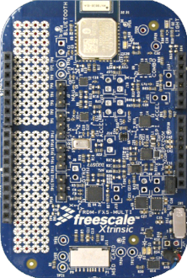
The 3-Axis Tilt Algorithm Returns the Same Value for all 4 Variations Below
East
North

Slide 123
Legend For Couple Slides…
Bold black are in-line structures
Bold red are function pointers
Normal text = scalars and pointers
Board-Specific Functions
Sensor-Specific
Generic Functions
run-time installable
functional interface
time
sequence
Legend

Slide 124
NXP Sensor Fusion for Kinetis MCUs Verson 7.xx
Application-specific bare metal or RTOS-based main()
Sensor Fusion Core Functions
initSensor FusionGlobals()
install Sensor()
initialize Fusion Engine()
read Sensors()
condition Sensor Readings()
runFusion()
<part>_Init()
<part>_Read()
The KSDK is available to main as well
Physical
Sensor #1 - n
ApplyGyroHAL()
ApplyMagHAL()
NVMSetBlockFlash()
ApplyAccelHAL()
initializeStatusSubsystem
queueStatus()
write()
updateStatus()
initializeControlPort()
Register_I2C_Read()
Sensor_I2C_Write()
Sensor_I2C_Read()
Register_SPI_Read()
Sensor_SPI_Write()
Sensor_SPI_Read()
setStatus()
stream()
control flags
Status SubSystem
Control SubSystem
Intelligent Sensor SDK
NonVolatile Storage
Board specific Hardware Abstraction Layer
GPIO
UART
I²C / SPI
Flash Memory
KSDK = Kinetis Software Design Kit

Slide 125
9-axis Accel + Mag + Gyro Complementary Indirect Kalman Filter
Precision Accelerometer Trim
accelerometer
signal
Accelerometer Corrections
Kalman Filter
The Kalman state vector is composed of:
q_{gε,k} orientation error w/r to gravity
q_{mε,k} orientation error w/r to magnetic field
b_{ε,k} error in zero rate gyroscope error
gyro signal
Gyro Corrections
Gyro offsets
Magnetic Compensation
Orientation
Linear Acceleration
Compass Heading
Euler Angles
magnetometer
signal
Magnetic Calibration

